Slide 1
Academic Consortium for Integrative Medicine & Health
Integrative Approaches for Common Adolescent and Young Adult (AYA) Conditions:
Anxiety, Sleep Disorders, and Disordered Eating
Melanie A. Gold, DO, DMQ, DABMA Columbia University, New York, NY, USA
Maria R. Mascarenhas, MBBS Children's Hospital of Philadelphia; University of Pennsylvania, Philadelphia, PA, USA
David W. Miller, MD, LAc UH Connor Whole Health, Cleveland, OH, USA
Thursday, March 6, 2025

Slide 2
Objectives
Appreciate the magnitude, impact on whole health, and inter-relatedness of anxiety, disrupted sleep, and disordered eating in the adolescent and young adult (AYA) population.
Identify approaches and theoretical frameworks that can be of appeal to the AYA population, making intervention more successful for the patient and more enjoyable for the healthcare provider.
Describe training resources and opportunities for further learning for participants, so they can continue to develop their own skills and methods with the AYA population using integrative health modalities.
Gain awareness of treatment techniques and their application towards improving anxiety, sleep, and disordered eating specifically in adolescents.

Slide 3
Case
DB is a 16 y.o. female with a history of family mental illness and complex trauma who presents with anxiety, IBS, sleep disruption, headaches, back pain, and arm pain. She eats about 1 meal per day, and has a hard time falling asleep and staying asleep. She has irregular sleep habits. Lab work reveals a Vitamin D of 18 (30-100), B12 of 317 (optimal above 600), Ferritin of 18.7 (11-306). She has a hard time regulating her daily activities, often gets overwhelmed by thoughts of past events and worries about what other kids think about her. She has emesis episodes that are preceded by nausea and a sense of a hot flash, and chocolate, eggs, red sauce, and pepperoni will trigger events. She sleeps about 6 hours per night and has an irregular sleep schedule. She reports that she frequently can’t fall asleep, and she wakes early.

Slide 4
Background Research
Sleep Pathologies and Eating Disorders: A Crossroad for Neurology, Psychiatry and Nutrition
Associations between Sleep and Mental Health in Adolescents: Results from the UK Millennium Cohort Study
Depression, Anxiety and Eating Disorder-Related Impairment: Moderators in Female Adolescents and Young Adults
Anxiety Sensitivity and Sleep-Related Problems in Anxious Youth
Anxiety Disorder Symptoms at Age 10 Predict Eating Disorder Symptoms and Diagnoses in Adolescence

Slide 5
“Anxiety disorders constitute the most common class of mental health disturbance in childhood, affecting roughly 12 to 20% of youth.” (Werner CL, et al)
“Insomnia has been generally estimated to be a problem in about 20–25% of young people, but its prevalence was surely underestimated due to the concomitant inclusion of the pediatric population along with adolescents. To note, data from the literature indicate that insomnia during adolescence is underreported, under-diagnosed (or mis-diagnosed) and, therefore, under (or mis-) treated.” (Uccella, et al)
“The available evidence from 32 studies comprising large samples from 16 countries showed that approximately 22% of children and adolescents showed disordered eating according to the SCOFF tool.” (López-Gil JF, et al)
“Over 50% of adolescents aged 9–19 years old with insomnia have a comorbid psychiatric disorder, such as depression or anxiety.” (Shochat, T, et al)

Slide 6
Anxiety
David W. Miller, MD, LAc UH Connor Whole Health, Cleveland, OH, USA

Slide 7
Disclosures
None

Slide 8
What does Anxiety represent?
Effort to stay safe:
physically
mentally
emotionally
spiritually
socially

Slide 9
Multiple patterns – not one pathway
Specific fears – Mimulus Flower Essence
General fears – Aspen Flower Essence
More worry/rumination – serotonin, gaba
More fear – fight, flight, freeze – excess epinephrine/norepinephrine (amygdala)
More mania – excess beta adrenergic
More irritability – excess cortisol
More grief/fear of loss – lack of dopamine, oxytocin

Slide 10
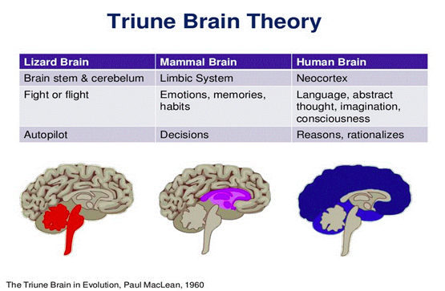
Regardless – anxiety is a neurobiologic circuit
Adolescents frequently appreciate “a” science of anxiety explanation – destigmatize
Neocortex – responds to cognitive interventions
Limbic system – responds to emotional modulators
Brainstem – responds to physical signals
Body – reflects anxiety in body postures and muscle tone
All levels interrelate!!!
NOTE: Triune brain theory is known to be limited!
Steffen PR, Hedges D, Matheson R. The Brain Is Adaptive Not Triune: How the Brain Responds to Threat, Challenge, and Change. Front Psychiatry. 2022 Apr 1;13:802606. doi: 10.3389/fpsyt.2022.802606. PMID: 35432041; PMCID: PMC9010774.

Slide 11
Braz J Psychiatry. 2019 May-Jun; 41(3): 261–269.
Published online 2018 Dec 6. doi: 10.1590/1516-4446-2018-0183
From anatomy to function: the role of the somatosensory cortex in emotional regulation
…a converging body of literature has shown that the somatosensory cortex also plays an important role in each stage of emotional processing, including identification of emotional significance in a stimulus, generation of emotional states, and regulation of emotion.
Importantly, studies conducted in individuals suffering from mental disorders associated with abnormal emotional regulation, such as major depression, bipolar disorder, schizophrenia, post-traumatic stress disorder, anxiety and panic disorders, specific phobia, obesity, and obsessive-compulsive disorder, have found structural and functional changes in the somatosensory cortex.

Slide 12
Nonetheless – this is a useful structure
Neocortex – cognitive reframing, visualization of different outcomes, mindfulness/metacognition, distraction, management of internal dialogs
Limbic System – music, art, positive emotional content
Brainstem -- breathwork, warming
Body – management of posture
In reality, many of these are complex interventions – also acupuncture, massage, yoga, tai chi, others

Slide 13
Internal Dialogs
Highly and longitudinally described –
“Self-talk is a ubiquitous human phenomenon.”
Chinese Medicine describes this well via the “Po Spirits” and “Po Demons”.
FALLEN ARROW --
Oleś PK, Brinthaupt TM, Dier R, Polak D. Types of Inner Dialogues and Functions of Self-Talk: Comparisons and Implications. Front Psychol. 2020 Mar 6;11:227. doi: 10.3389/fpsyg.2020.00227. PMID: 32210864; PMCID: PMC7067977.

Slide 14
Po Management – Fallen Arrow
Regulate the breathing
Cognitively ‘step back’
Identify the dialog
Note stereotypy
Build insight and metacognition
Reframe and identify a counter dialog
Perspective set
Appreciate effort to protect
Find humor where possible
Note – these dialogs can be activated through negative life experiences (consider epigenetic upregulation) – if possible, identify origins or connect to family history
You can’t fly
You will fail
You should quit!

Slide 15
Strategies for Internal Dialog Management
Identify the counter dialog.
Make a plan.
Take it to the full conclusion.
Visualize multiple possible outcomes.
Take it to absurd conclusions.
Identify origins.
Reframe for personal strengths.
Appreciate your wanting to take care of you.
Perspective set.

Slide 16
Multi-Modal Integrative Approaches to Sleep with Adolescents and Young Adults
Melanie A. Gold, DO, DMQ, DABMA, FAAP
Special Lecturer in Pediatrics and in Population & Family Health
Columbia University Irving Medical Center

Slide 17
DISCLOSURES
Bayer – Consultant, Nonproduct-Related Speaker
5 Point App – Consultant
The Tapping Solution LLC and The Tapping Solution Foundation – Consultant March to August 2024
The Tapping Solution, Scientific Advisory Board member 2020-Present (Uncompensated)
Policy and Research Group - Consultant
Notes:
None of these disclosures are directly relevant to this presentation but I have received funding from these sources in the past 24 months

Slide 18
Sleep in Adolescents and Young Adults (AYAs)
AYAs have poor sleep. Poor sleep hygiene, shorter sleep duration, and poor sleep quality, including sleep disruptions, are prevalent.
Sleep hygiene education interventions
Improve sleep quality in younger children and college students
None focus on high school students, who have specific developmental needs
Mind-Body Integrative Health (MBIH)
Mindfulness, yoga, self-hypnosis, acupressure
Improve sleep quality in adults by reducing stress
Rarely applied to adolescent sleep, despite being shown to reduce stress in adolescents

Slide 19
Multi-Modal Integrative Approaches to Sleep
Research Interventions and Initiatives
Sleeping Healthy, Living Healthy (SHLH)
Resident Education in Sleep Techniques (REST) for adolescents and young adults
Comfort Box
Aroma Acupoint Therapy with Stress Relief Kit
Settings
School Based Health Centers (SBHCs) in NYC Public Schools
Inpatient at a Tertiary Care Children’s Hospital in NYC

Slide 20
Multi-Modal Integrative Approaches to Sleep
Acupressure
Aromatherapy
Aroma Acupoint Therapy (AAT)
Breathing techniques (4:7:8, square, 3-part yogic breathing, alternate nostril breathing, Sitali, Sitkari)
Emotional Freedom Techniques (EFT) Tapping
Mindfulness: Mindful breathing, Body awareness, Letting go
Self Hypnosis
Self Massage

Slide 21
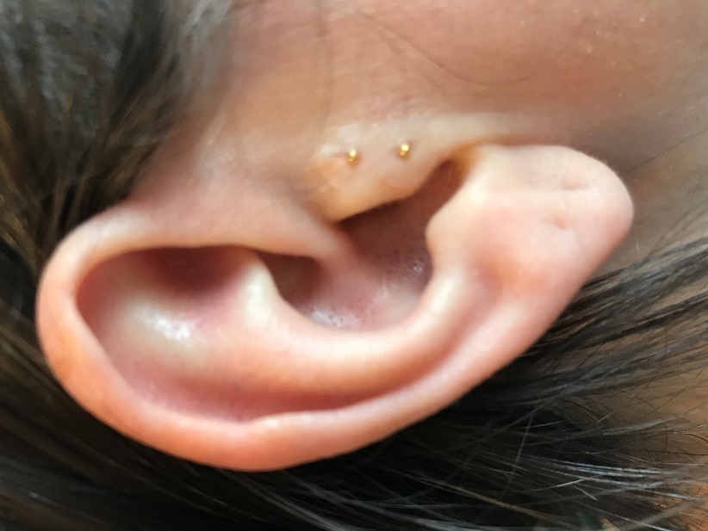
Research on MBIH Approaches to Sleep
Needs assessment on providing Integrative Therapies at SBHCs
↓
Assess SBHC patients’ sleep quality & interest in participating
in a Mind-Body Integrative Health Sleep Intervention
↓
Develop & pilot test Sleeping Healthy/Living Healthy (SHLH) Intervention at 2 SBHC using acupressure, tapping, and mindfulness (R21 NIMHD)
↓
Modify SHLH curriculum for pediatric Resident Education in Sleep Techniques (REST) Program Evaluation Study

Slide 22
Sleeping Healthy Living Healthy (SHLH) Development & Pilot Testing of a Sleep Hygiene and Mind-Body Integrative Health (MBIH) Intervention for Adolescents

Slide 23
Specific Aims
Develop and test feasibility of a novel intervention combining evidence-based sleep education with mind-body integrative health (MBIH) approaches to improve sleep quality among adolescents with poor sleep quality at urban school-based health centers (SBHCs)
Assess intervention efficacy in a two-arm pilot randomized controlled trial, with half receiving:
Sleeping Healthy Living Healthy (SHLH), the MBIH & sleep hygiene education intervention [intervention arm]
Sleep for Teens (SFT), a health education program of equal intensity and duration [control arm]

Slide 24
SHLH MBIH Sleep Practices
Mindful Breathing
Acupressure
Emotional Freedom Techniques (EFT) Tapping
Body Awareness
Letting Go Techniques and Mindful Attention

Slide 25
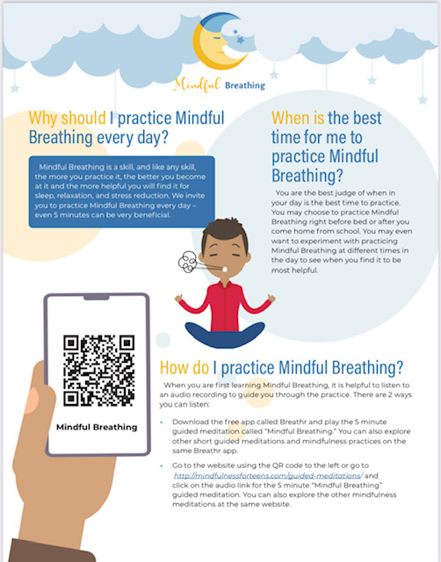
Mindful Breathing for Sleep from SHLH Study
Patient Resource

Slide 26
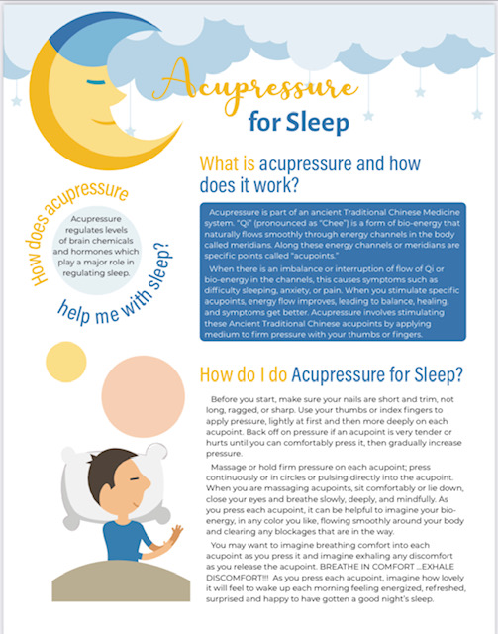
Acupressure for Sleep from SHLH Study

Slide 27
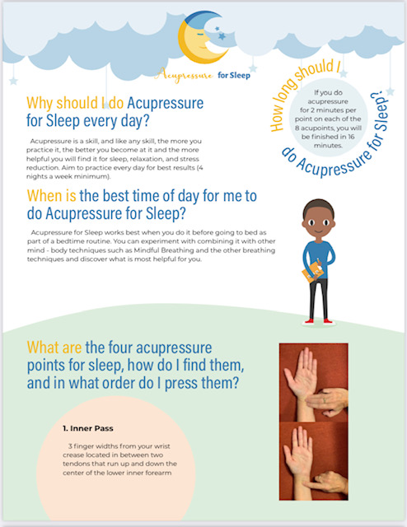
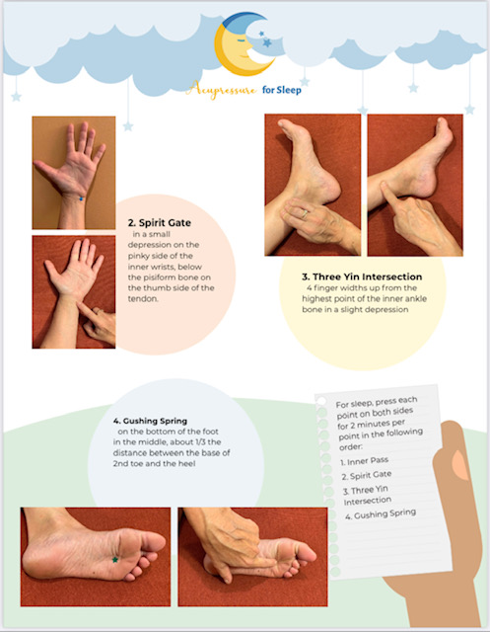
Acupressure for Sleep from SHLH Study

Slide 28
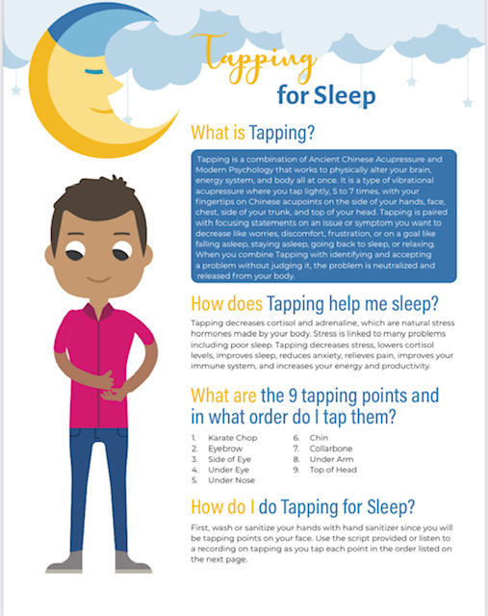
Tapping for Sleep from SHLH Study

Slide 29
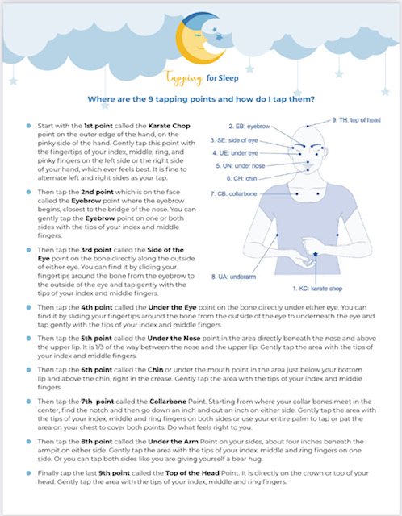
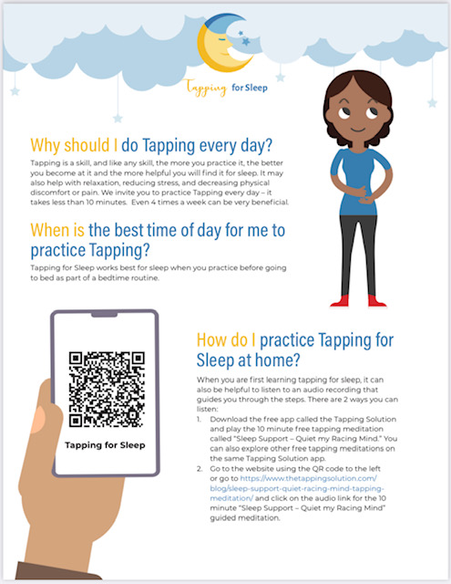
Tapping for Sleep from SHLH Study

Slide 30
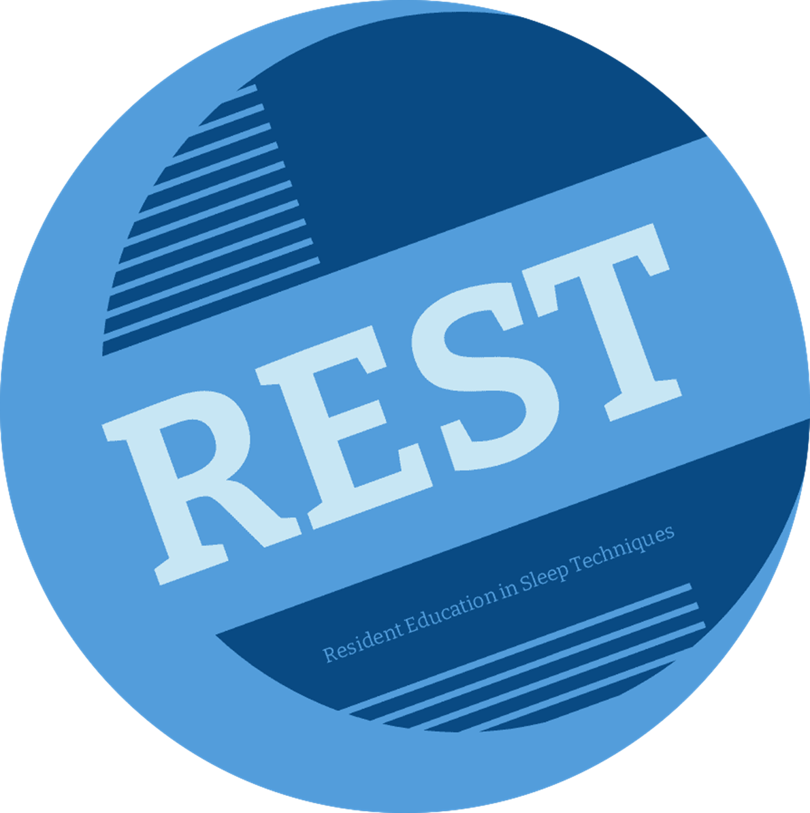
Sleeping Healthy / Living Healthy (SHLH)
Resident Education in Sleep Techniques (REST)
REST Program Weekly Curriculum:
Sleep topics & tips
Integrative sleep technique video
Patient resources and handouts
Development & Pilot Testing of a Sleep Hygiene and Mind-Body Integrative Health (MBIH) Intervention for Adolescents
Funding
Lerner Grant FY23
Funding
R21 MD013991 (Garbers & Bruzzese)
Notes:
MG

Slide 31
REST MBIH Sleep Practices
Mindful Breathing
Letting Go Techniques
Body Awareness
Aromatherapy
Acupressure
Self Hypnosis
EFT Tapping
Introduction to Sleep Kit
4-7-8, Square, and 3 Part Yogic Breathing
Alternate Nostril Breathing, Sitali, and Sitkari Breathing
Sleep Ergonomics
Self Massage

Slide 32
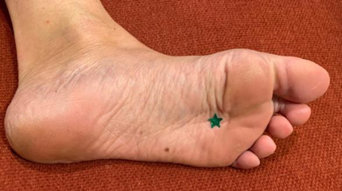
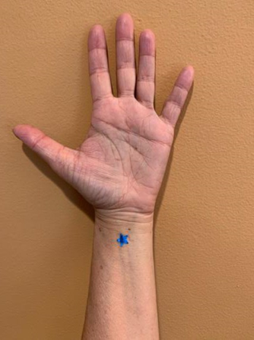
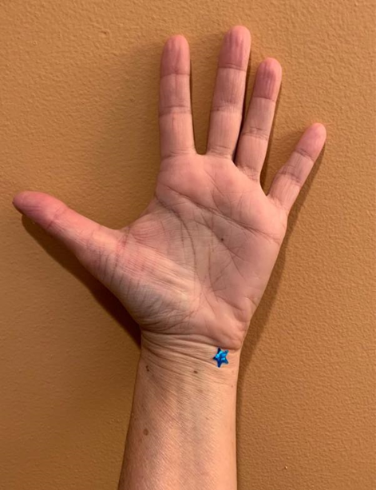
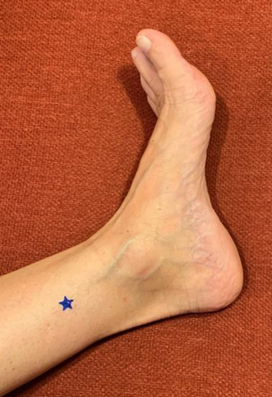
Acupressure
Notes:
MB (head and wrist) & MG (ankle and foot)

Slide 33
Aromatherapy
Notes:
MB

Slide 34
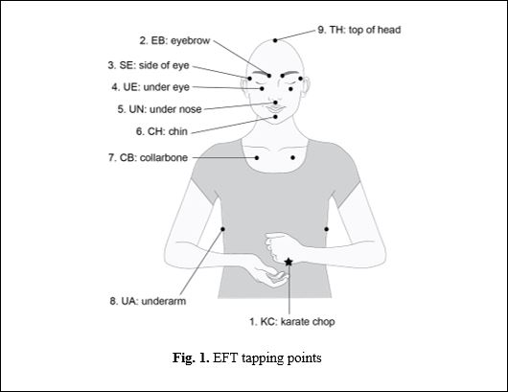
EFT Tapping

Slide 35
REST Sleep Topics & Tips
Benefits of a good night’s sleep
Shift Work
Sleep Environment
Napping
Progressive Muscle Relaxation
Deep Belly Breathing
Calming Your Body for a Restful Night’s Sleep
Reading & Journaling
Technology Break
Bedtime Foods
Exercise
Quiet Mind

Slide 36
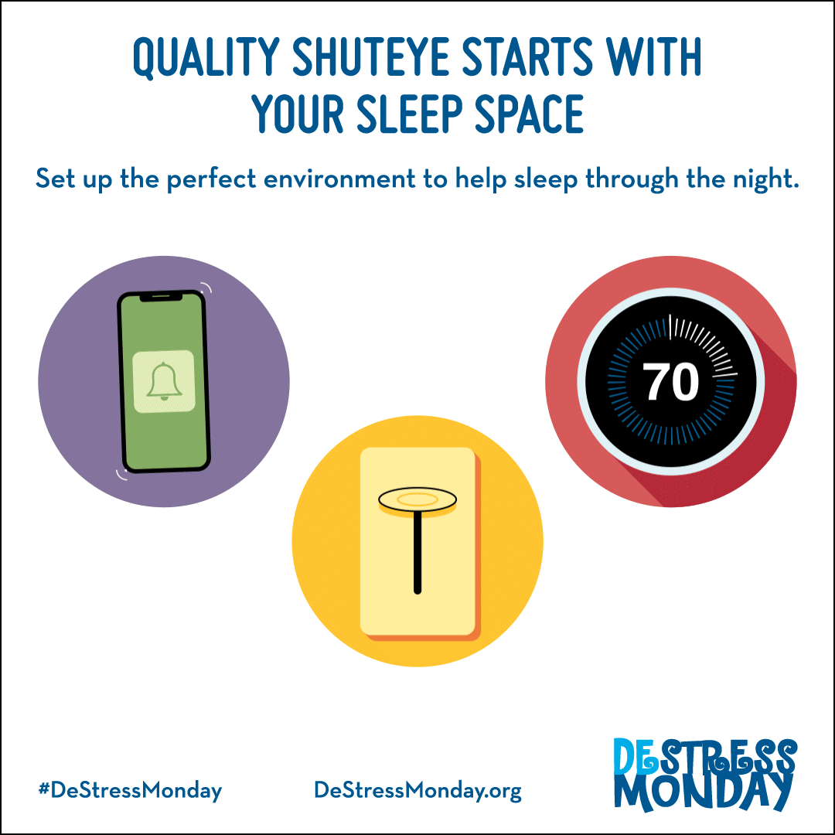
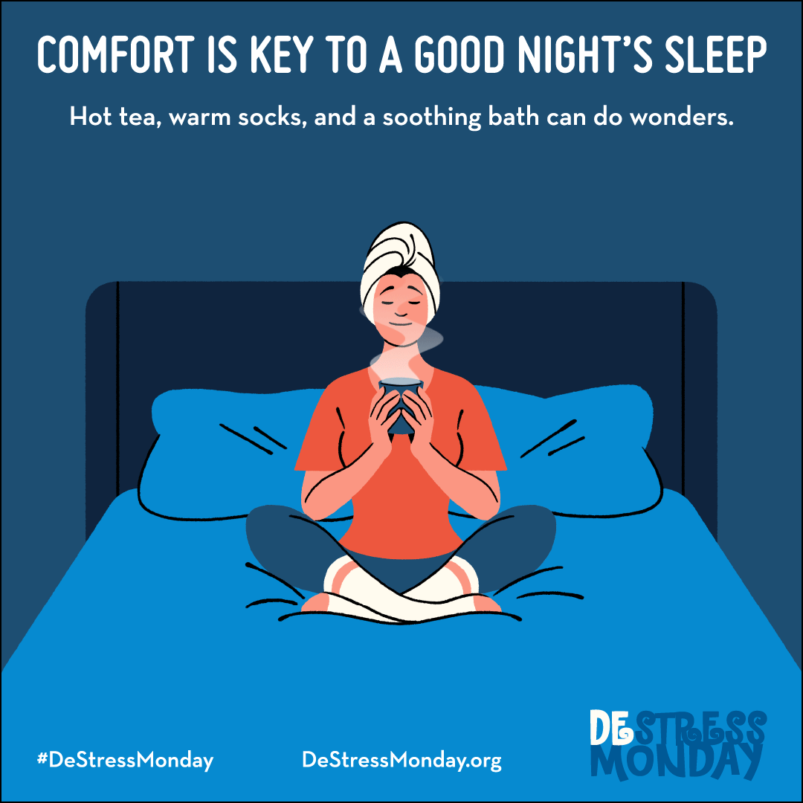
Sleep Topics & Tips

Slide 37
Patient Handouts & Resources: Weeks 1-6
Mindful Breathing Mindful Breathing Benefits of Good Sleep
Letting Go Sleep Wake Routines
Body Awareness Sleep Environment
Aromatherapy
Acupressure Progressive Muscle Relaxation
Deep Belly Breathing ImaginAction QR Code Flyer

Slide 38
Patient Handouts & Resources
EFT Tapping Gorilla Thumps and Bear Hugs
Sleep Helpers Sleep Busters
4-7-8 Breath for Patient 4-7-8 Breath for Parent Square Breathing 3 Part Yogic Breathing
Alternate Nostril Breathing Sitali Sikari
Sleep Ergonomics
Facial Self Massage Body Self Massage

Slide 39
Book on Tapping for Children & Families

Slide 40
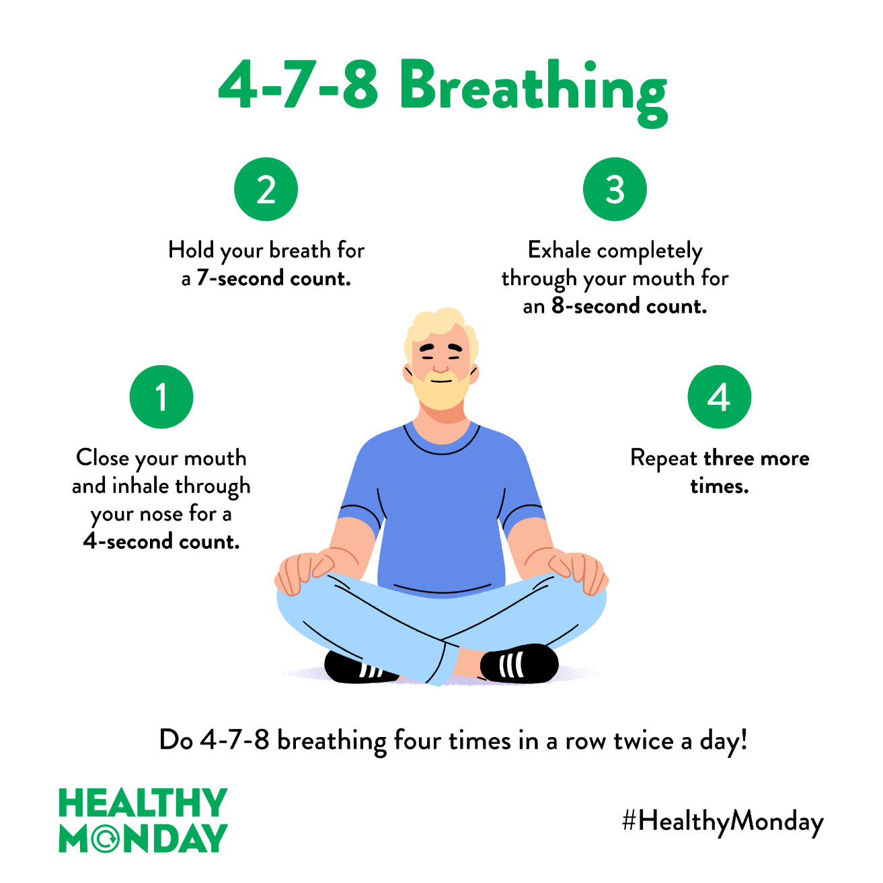
Patient Resources

Slide 41
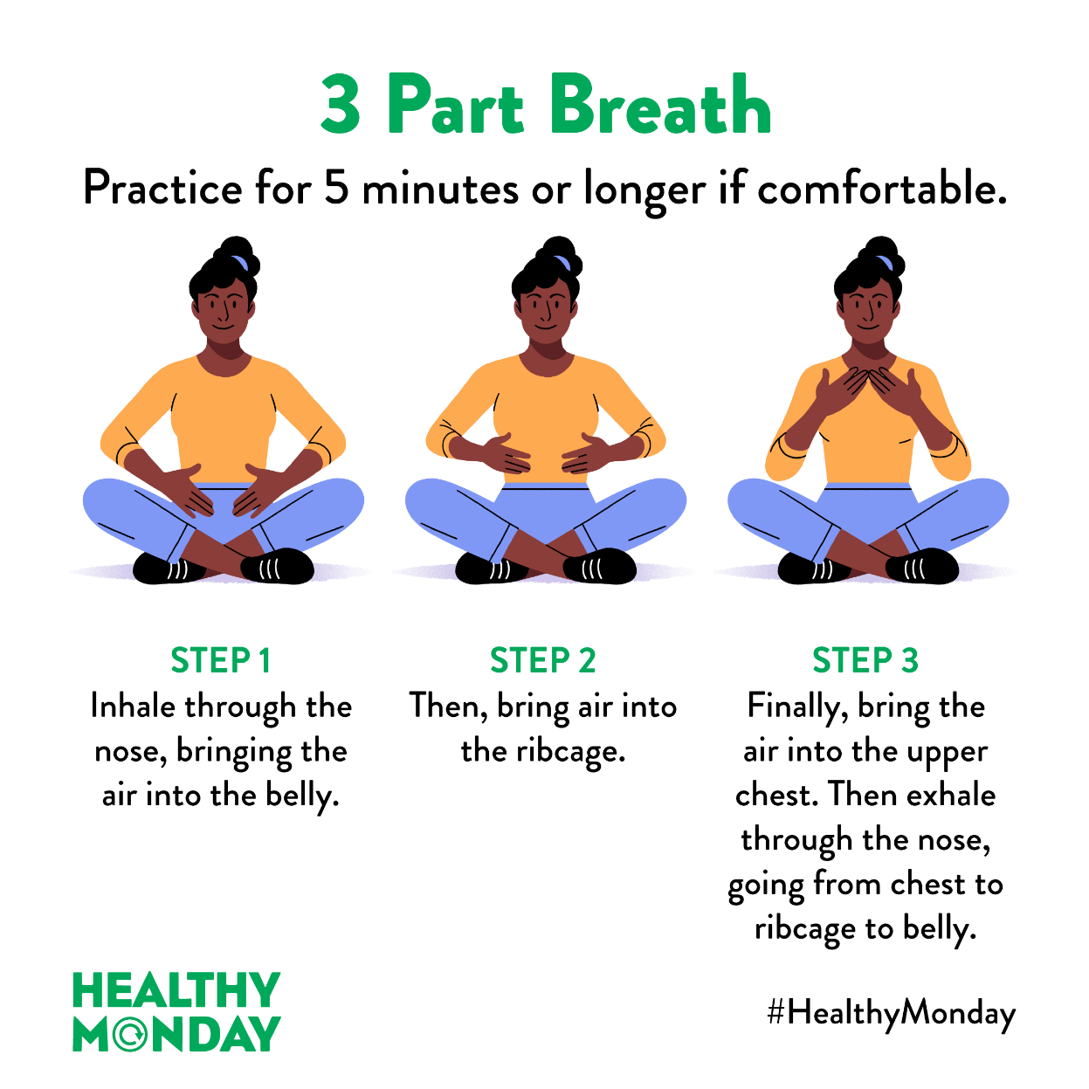
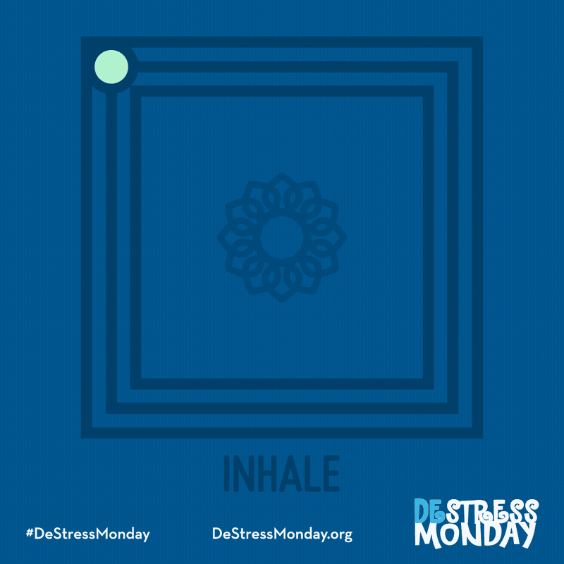
Patient Resources

Slide 42
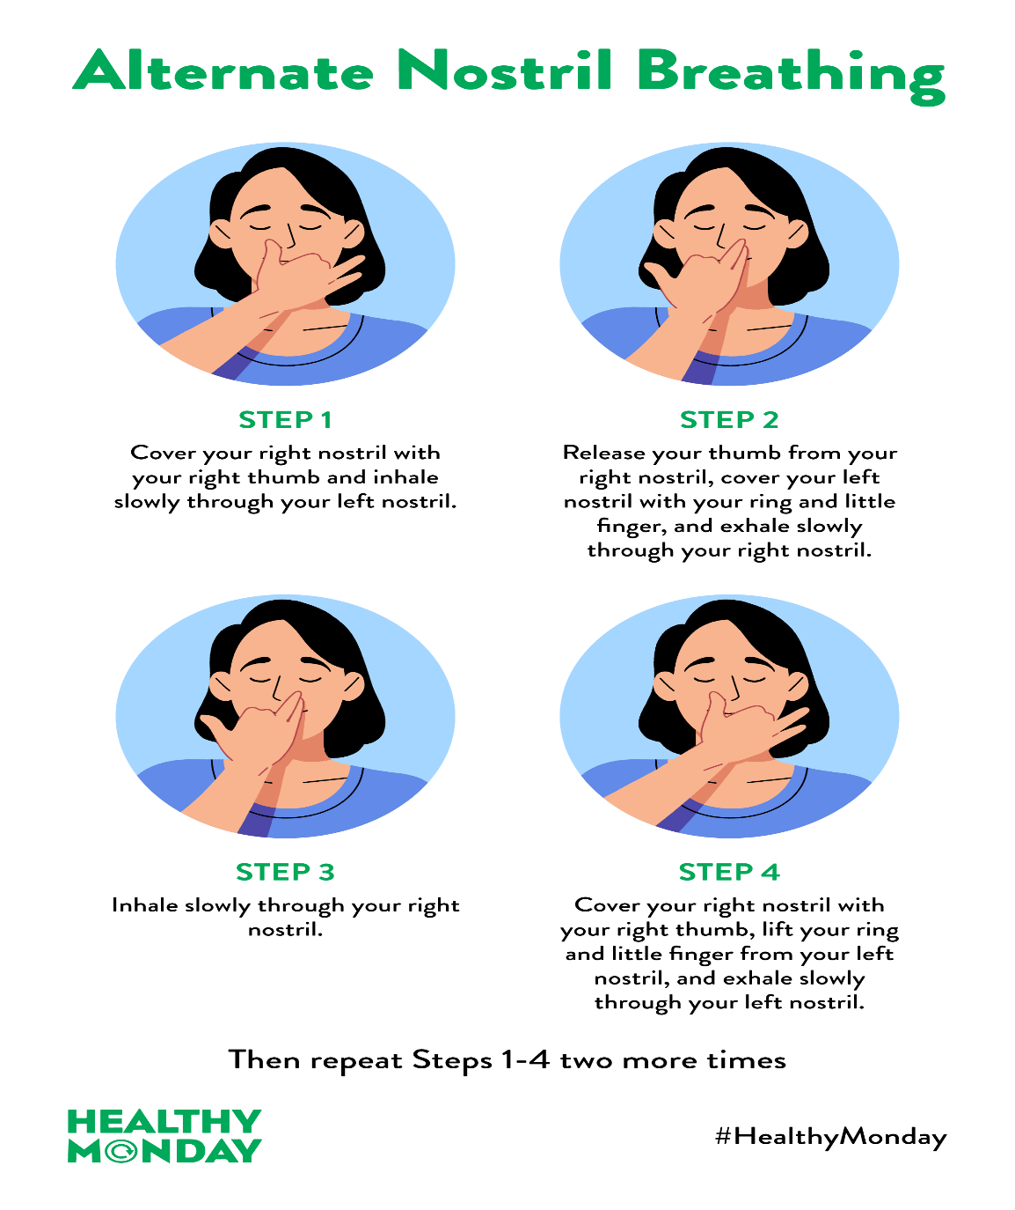
Patient Resource

Slide 43
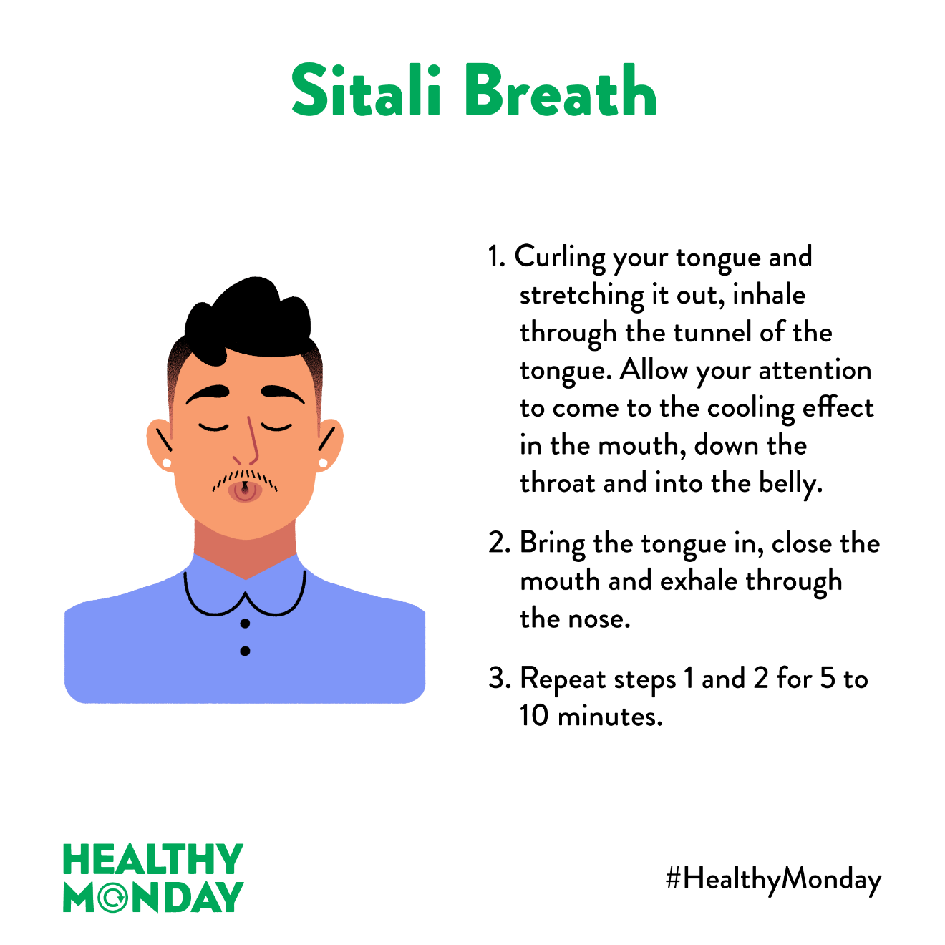
Patient Resource

Slide 44
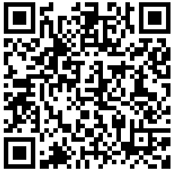
Resident Education in Sleep Techniques (REST) Curriculum with Sleep Topics, MBIH Sleep Techniques Videos, and Patient Handouts and Resources

Slide 45
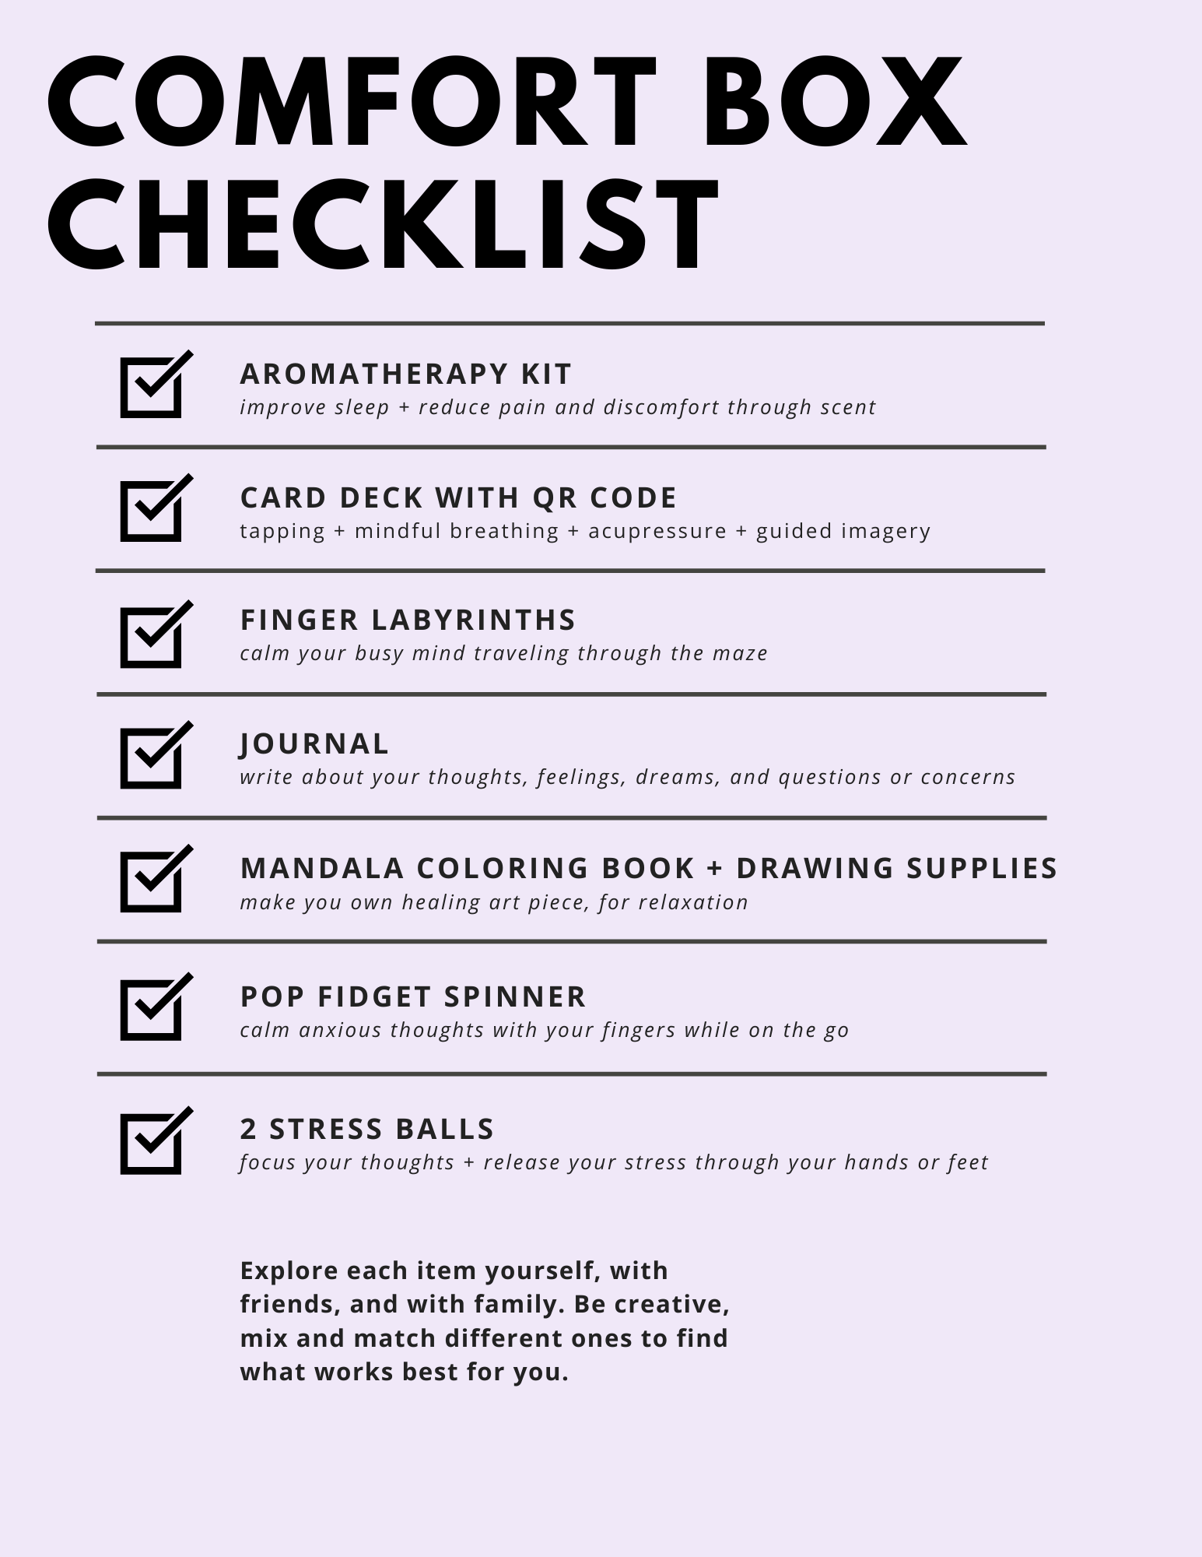
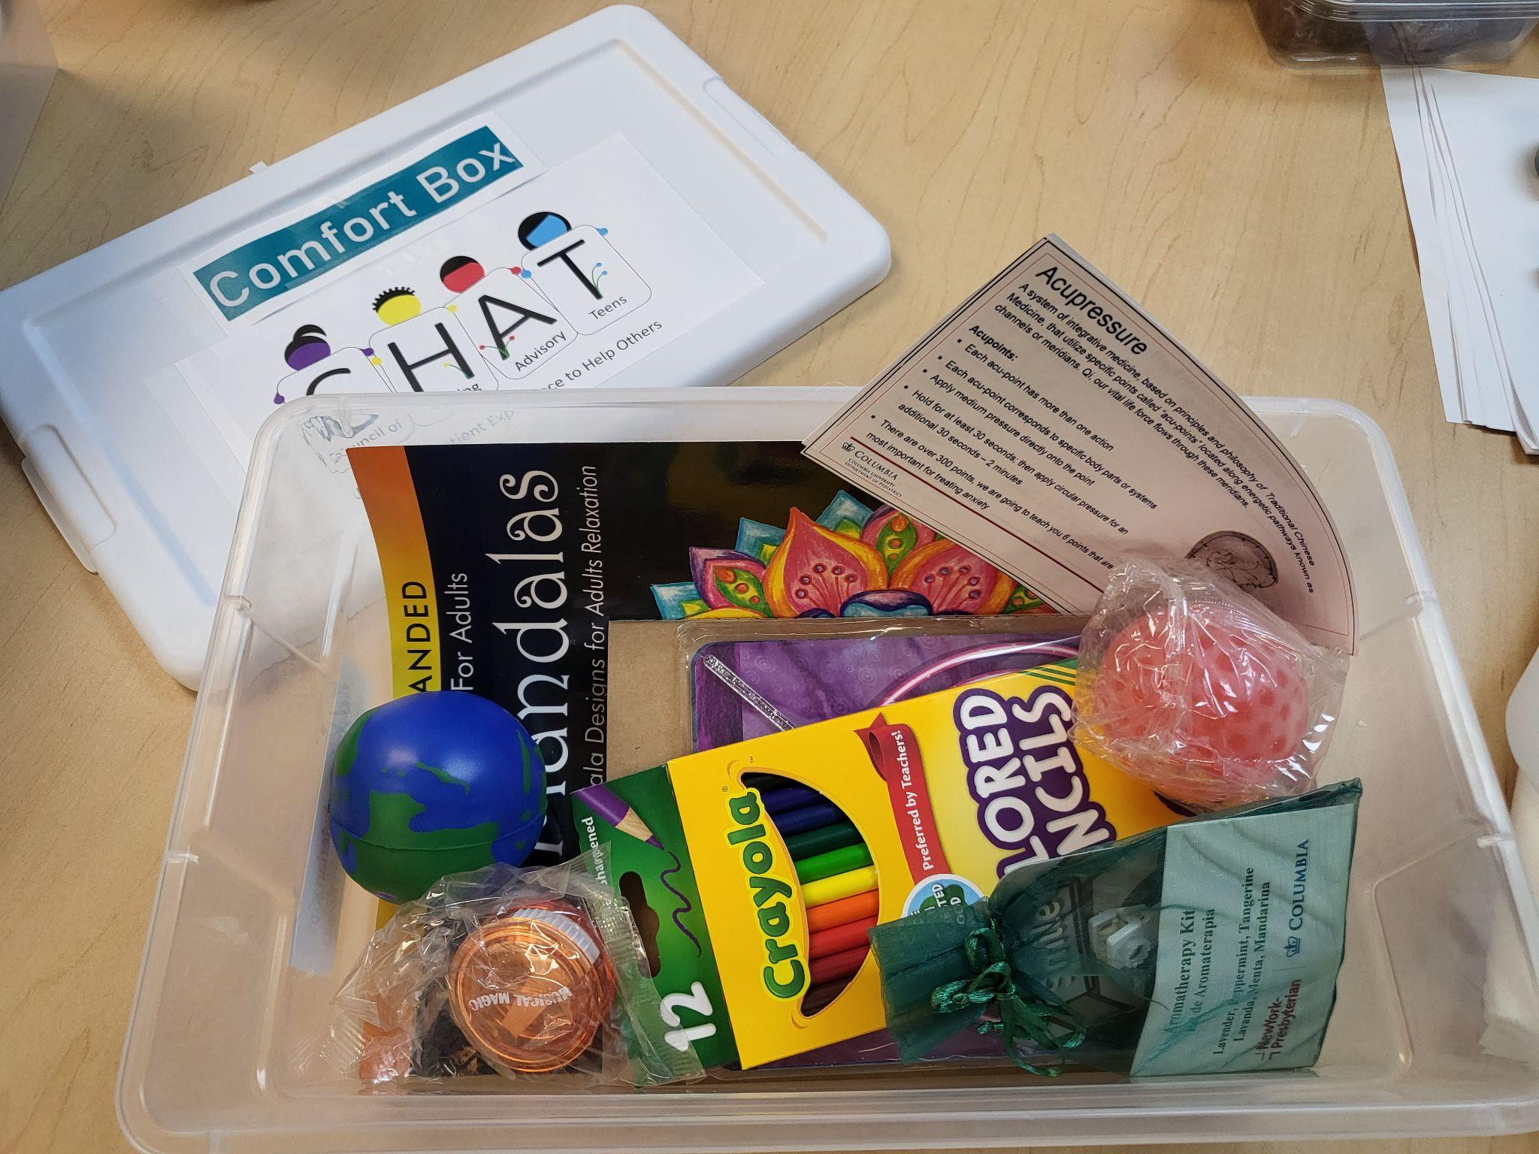
Comfort Box
Items to provide self-care for relief of symptoms commonly experienced by children and adolescents in inpatient and outpatient settings, including sleep

Slide 46
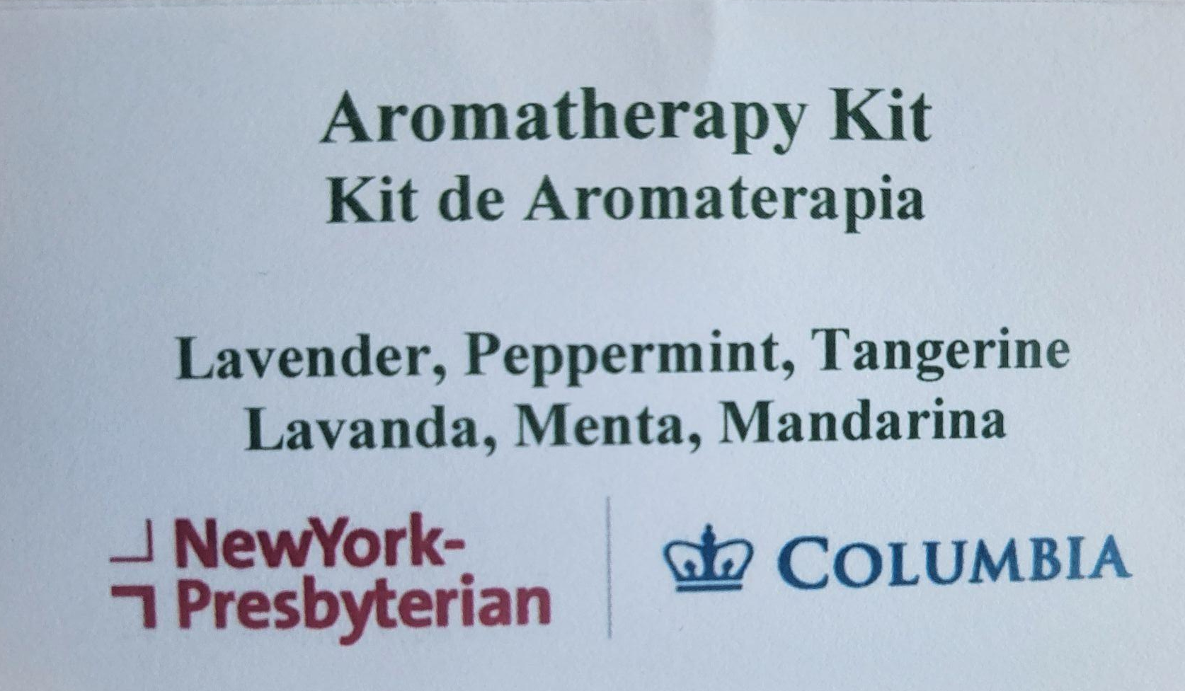
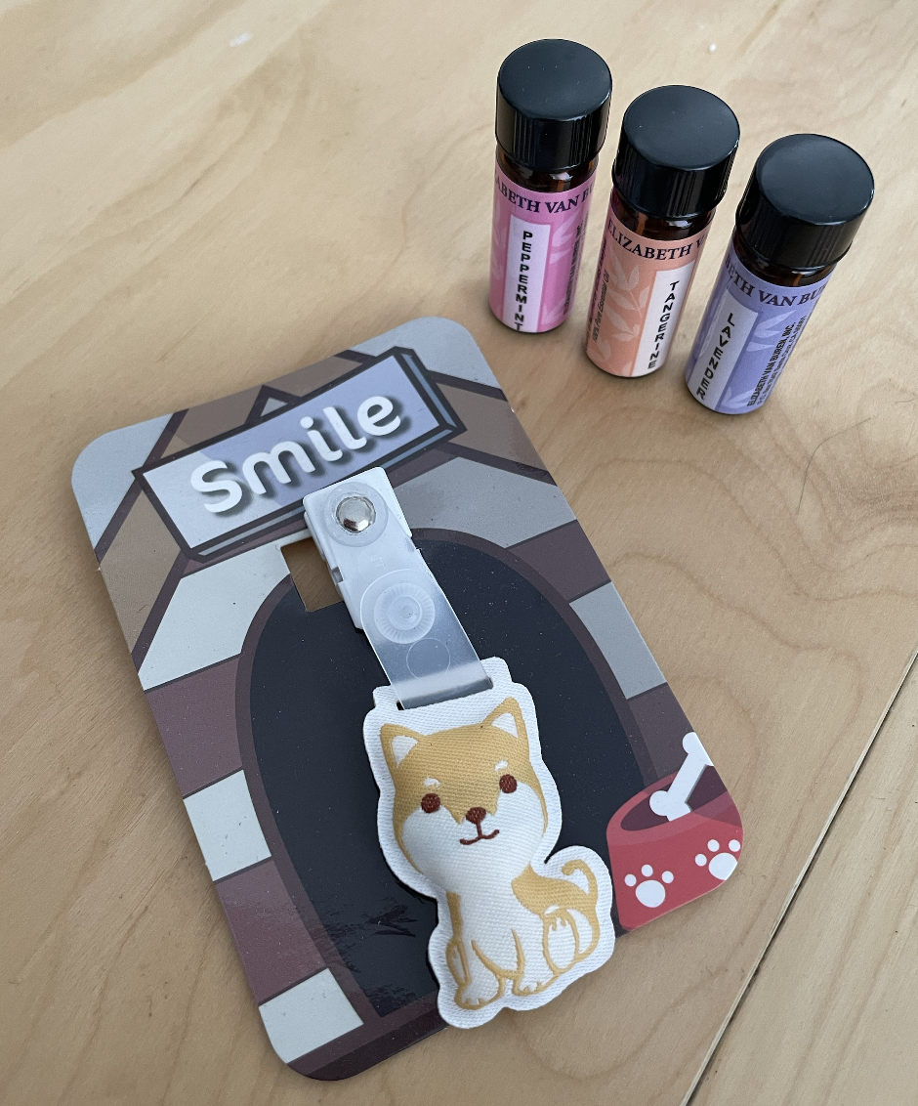
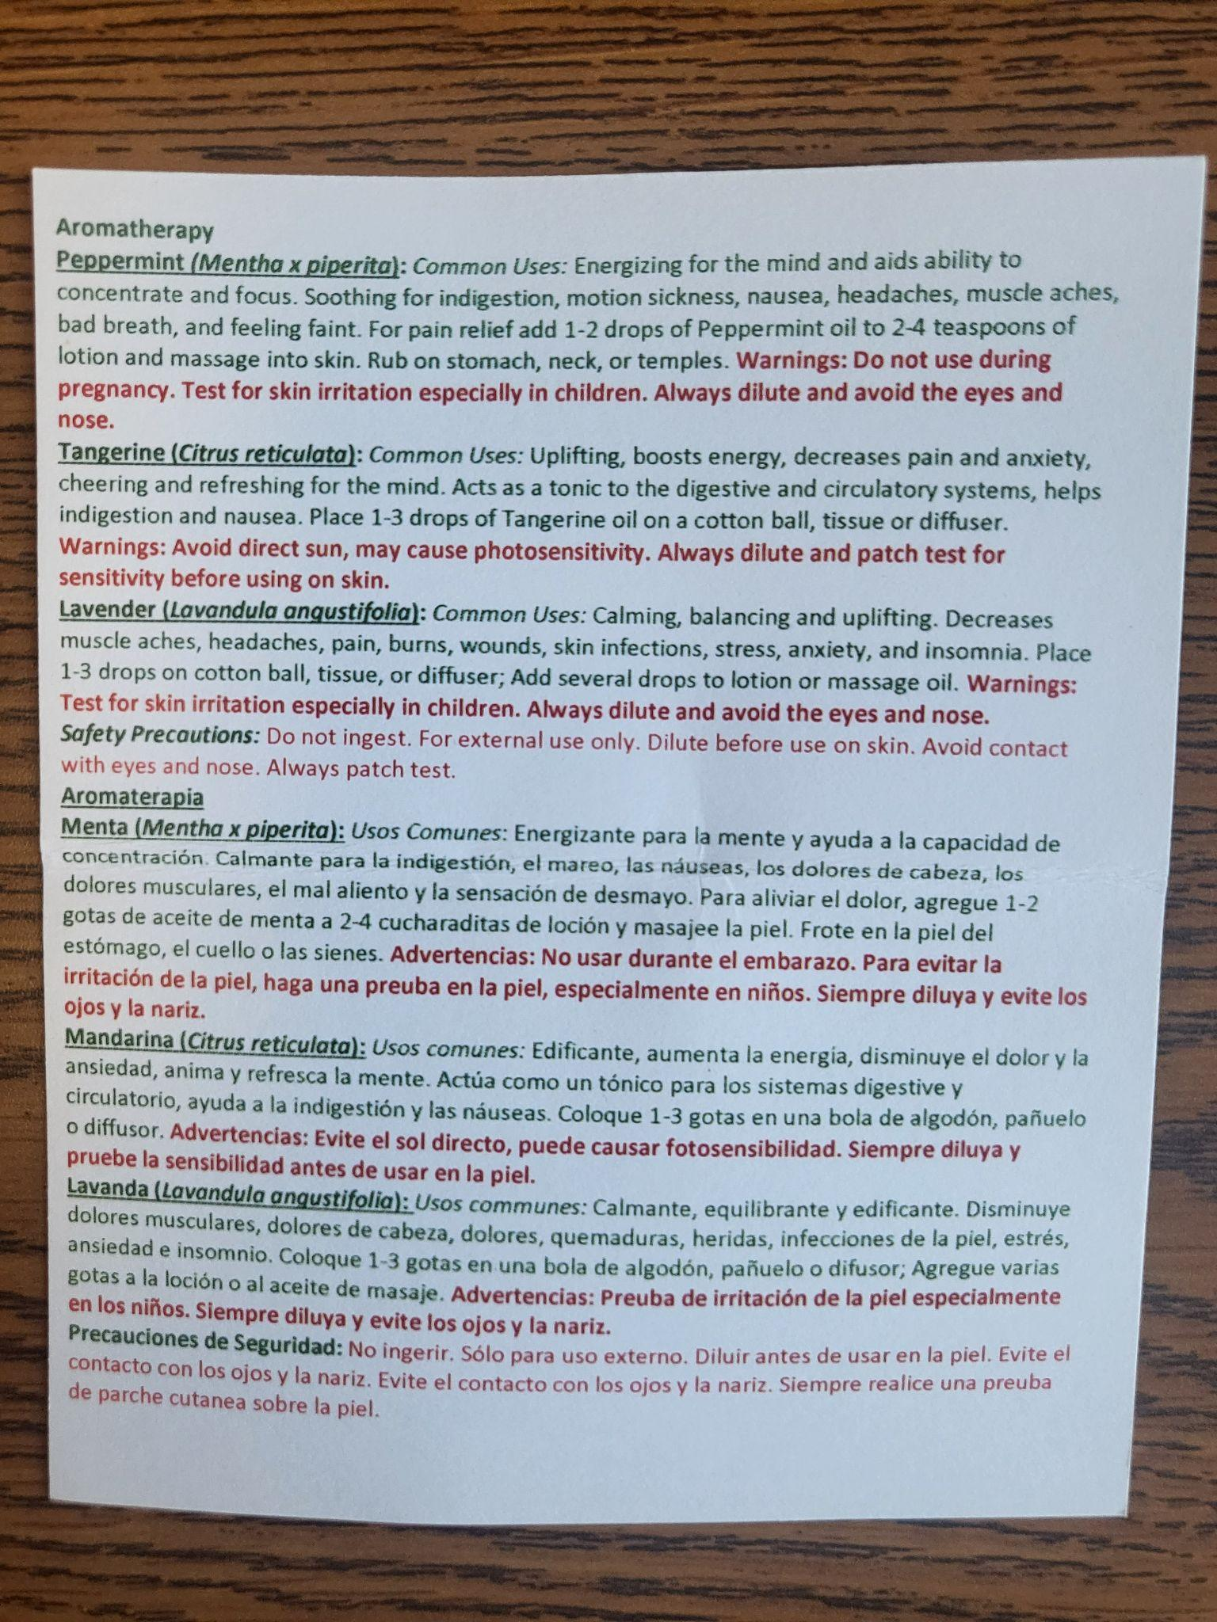
Aromatherapy kit:
Tangerine, Lavender, Peppermint

Slide 47
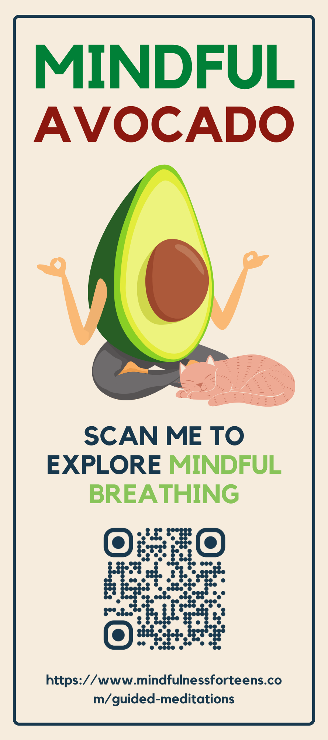
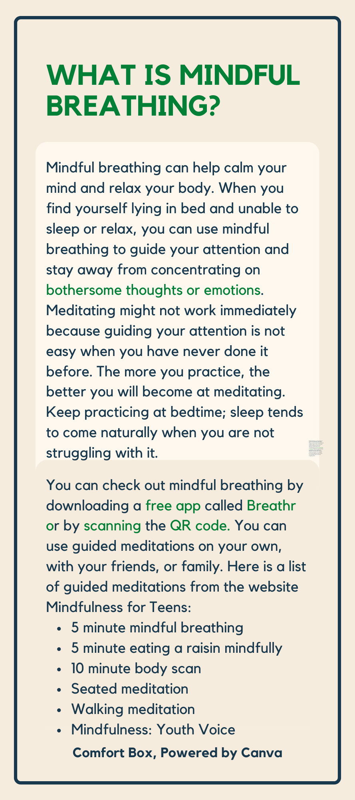

Slide 48
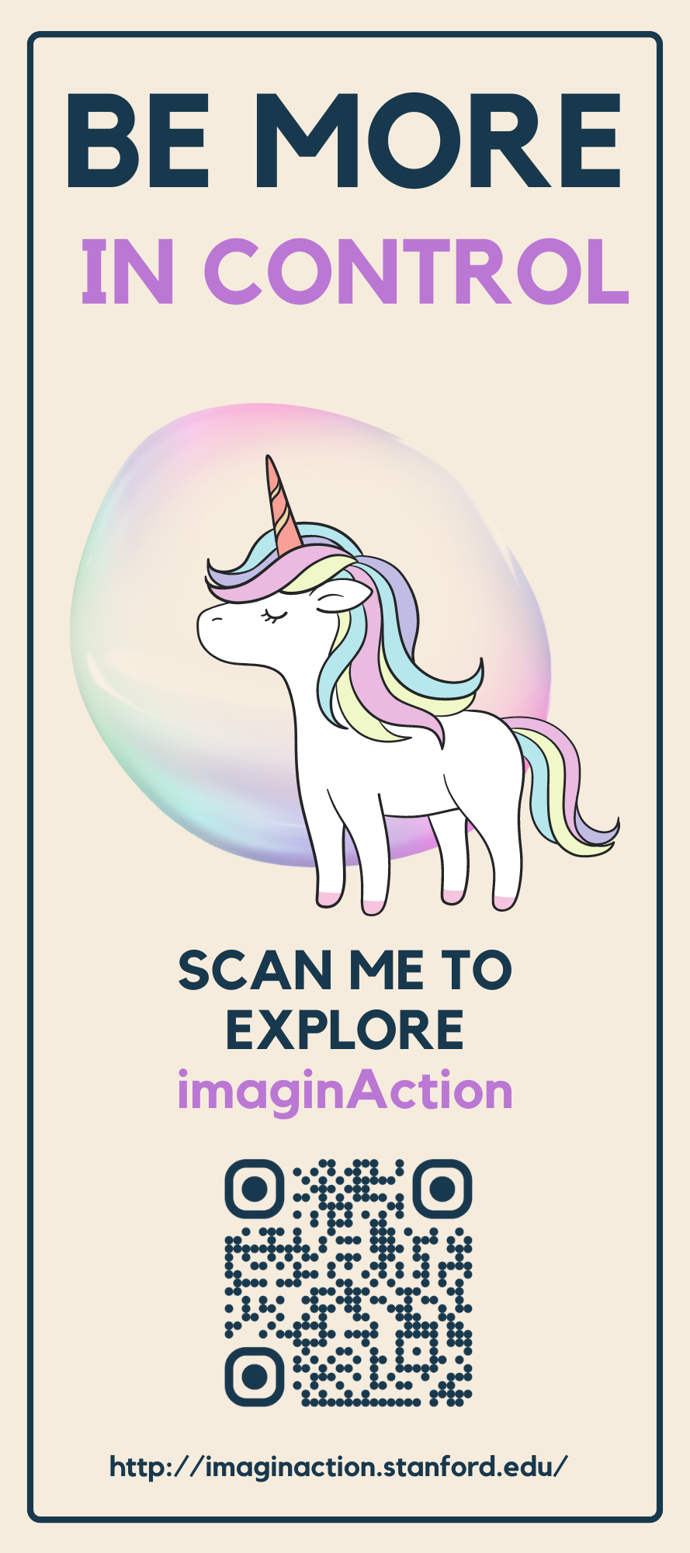
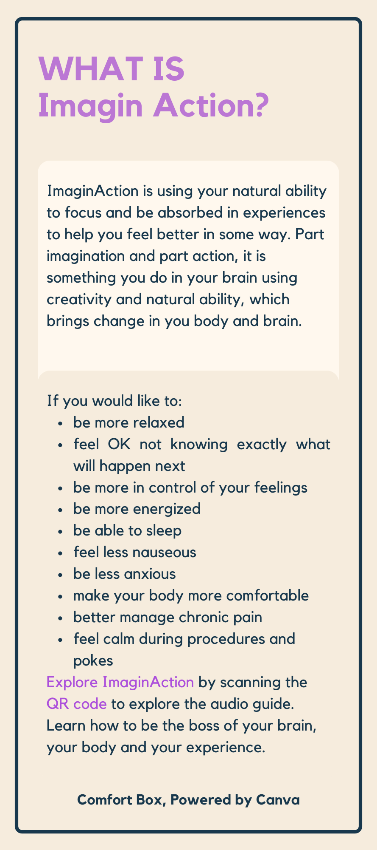
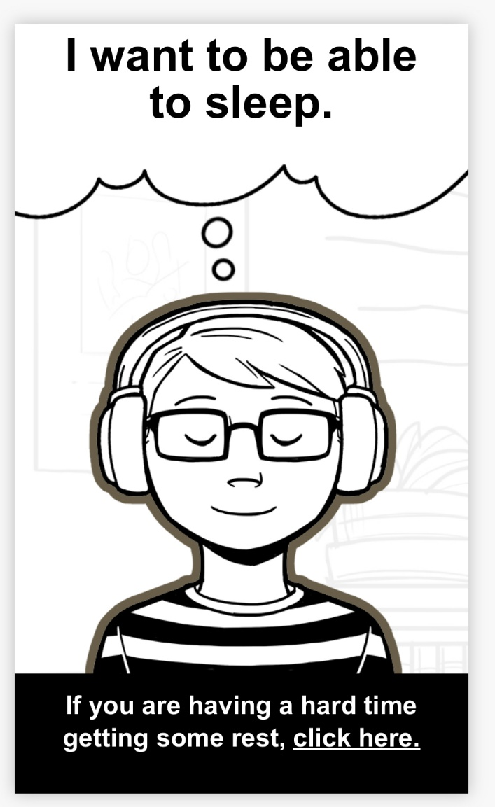
Imaginaction (Self Hypnosis)

Slide 52
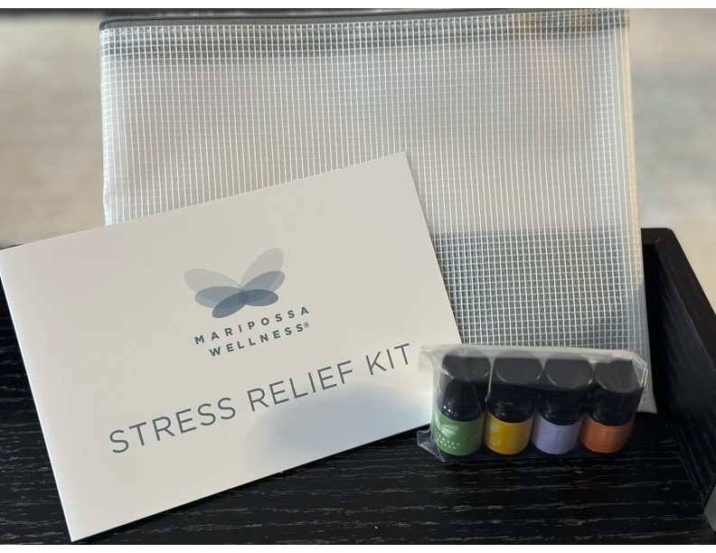
Aroma Acupoint Therapy (AAT): Stress Relief Kit
Stress Relief Kit: https://www.maripossawellness.com/shop/maripossa-wellness-stress-relief-kit

Slide 53
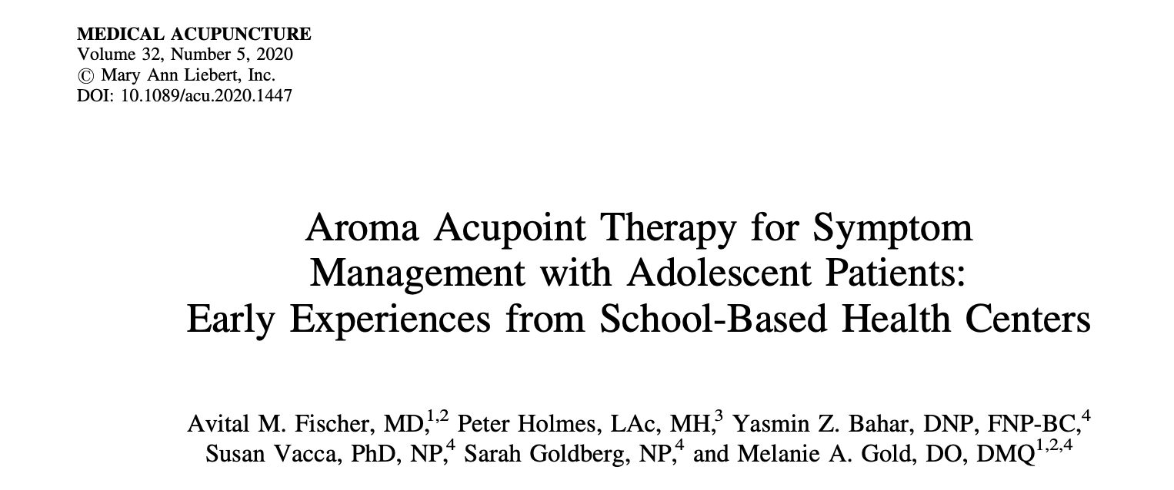
Aroma Acupoint Therapy Research in SBHCs Using Stress Relief Kit for Pain, Anxiety, Sleep, etc,

Slide 54
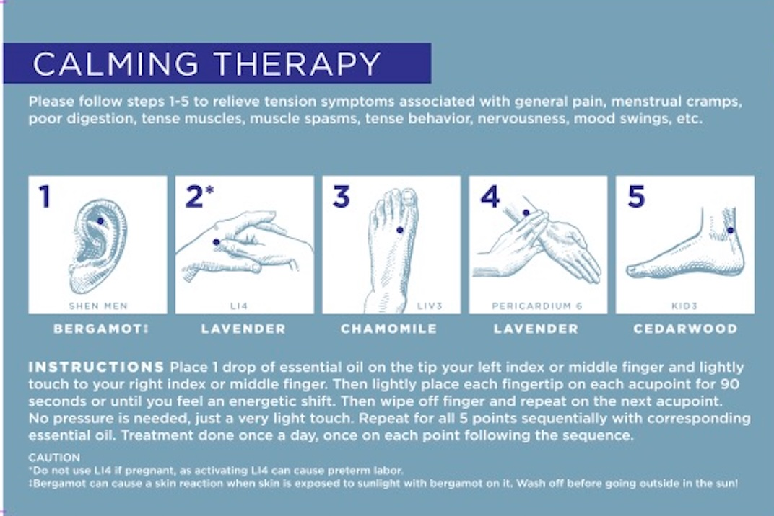
Stress Relief Kit: Calming Therapy
Stress Relief Kit: https://www.maripossawellness.com/shop/maripossa-wellness-stress-relief-kit

Slide 55
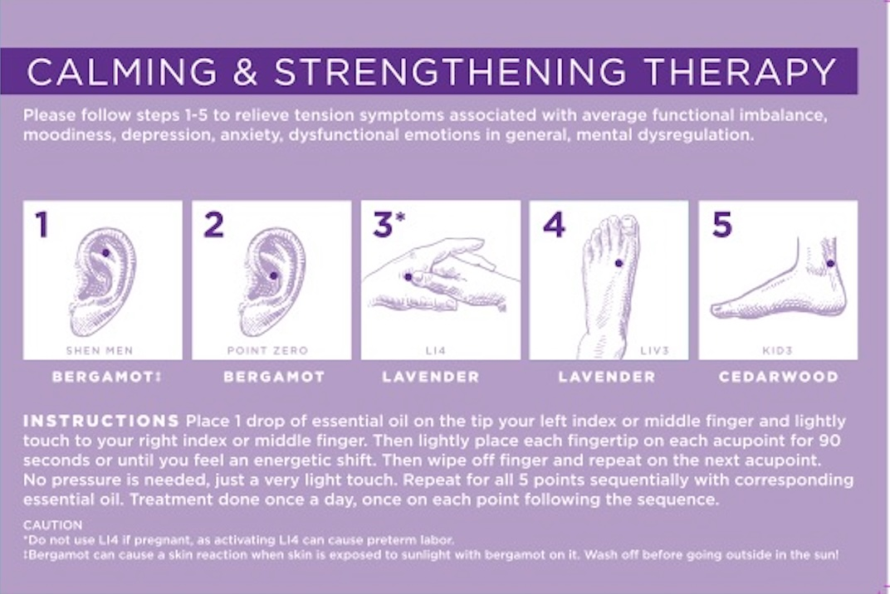
Stress Relief Kit: Calming and Strengthening Therapy
Stress Relief Kit: https://www.maripossawellness.com/shop/maripossa-wellness-stress-relief-kit

Slide 56
Multi-Modal Integrative Approaches to Sleep
Sleeping Healthy, Living Healthy (SHLH)
Resident Education in Sleep Techniques (REST) for adolescents and young adults
Comfort Box
Aroma Acupoint Therapy with Stress Relief Kit

Slide 57
Disordered Eating
Maria R Mascarenhas, MBBS
Children’s Hospital of Philadelphia
Notes:
number 348, titled “Integrative Approaches for Common Adolescent and Young Adult (AYA) Conditions: Anxiety, Sleep Disorders, and Disordered Eating”
the management of anxiety, disrupted sleep, and disordered eating, all common conditions among the AYA population, with a focus on using a variety of integrative tools. The presentation will start with a representative case vignette and practical strategies and clinical resources toward the management of the case will be shared. Discussion will include means of engagement that is collaborative with AYAs, making care more successful and enjoyable. Clinically meaningful integrative approaches will be discussed. Modalities to be covered include cognitive reframing, yoga and movement therapies, acupressure, Emotional Freedom Techniques (EFT) tapping, aroma-acupoint therapy, nutrition, herbal medicine, breathing techniques, expressive therapies, mindfulness, and self-hypnosis. Where applicable, literature will be referenced, and data shared from the presenters’ clinical sites. Resources will also be identified for further training and reference

Slide 58
Disclosure
I have co-authored a cookbook and will not mention it in this presentation

Slide 59
Golden 2015; Hormberger 2021
Notes:
Golden 2015
Modifications to the diagnostic criteria for anorexia nervosa (AN) include removal of a numeric cutoff for low weight; reliance on behavioral manifestations in addition to cognitive symptoms; and elimination of amenorrhea as a criterion necessary for the diagnosis. Although there is less emphasis on a specific weight cutoff, DSM5 recommends less than the fifth percentile body mass index (BMI)efor-age as suggestive of low weight. The criteria for bulimia nervosa (BN) include bingeing and compensatory behaviors once weekly for the past 3 months. Because the revised diagnostic criteria for AN and BN are more inclusive, application of DSM-5 criteria leads to a modest increase in both AN and BN. It also captures a significant number of young people who meet criteria for a new diagnostic category called Avoidant/Restrictive Food Intake Disorder (ARFID) [2e4]. Patients with ARFID do not have weight or shape concerns but restrict their dietary intake because of concerns about taste, texture, color, or smell or may not eat because of fear of swallowing or vomiting. As a result, they do not meet appropriate nutritional and/or energy needs [1]. Another new category called atypical AN describes patients who have lost significant amounts of weight and have other diagnostic features of AN but are not underweight. Binge eating disorder (BED) is officially recognized with similar binge criteria to BN but no compensatory behaviors.
AAP Hornberger LL, Lane MA, AAP THE COMMITTEE ON ADOLESCENCE. Identification and Management of Eating Disorders in Children and Adolescents. Pediatrics. 2021; 147(1):e2020040279
The ultimate goals of care in eating disorders are that children and adolescents are nourished back to their full healthy weight and growth trajectory, that their eating patterns and behaviors are normalized, and that they establish a health relationship with food and their body weight, shape, and size as well as a healthy sense of self. Independent of a specific DSM diagnosis, treatment is focused on nutritional repletion and psychological therapy. Psychotropic medication can be a useful adjunct in select circumstances
An important role for the pediatrician is to offer guidance regarding eating and to manage the physical aspects of the illnesses. For all classifications of eating disorders, reestablishing regular eating patterns is a fundamental early step. Meals and snacks are reintroduced or improved in a stepwise manner, with 3 meals and frequent snacks per day. Giving the message that “food is the medicine that is required for recovery” and promoting adherence to taking that medicine at scheduled intervals often helps patients and families get on track.130 A multivitamin with minerals can help ensure that deficits in micronutrients are addressed. To optimize bone health, calcium and vitamin D supplements can be dosed to target recommended daily amounts (elemental calcium: 1000 mg for patients 4–8 years of age, or 1300 mg for patients 9–18 years of age; vitamin D: 600 IU for patients 4–18 years of age).87,131 Patients can be reassured that the bloating discomfort caused by slow gastric emptying improves with regular eating. When constipation is troubling, nutritional strategies, including weight restoration, are the treatments of choice.111 When these interventions are inadequate to alleviate constipation, osmotic (eg, polyethylene glycol 3350) or bulkforming laxatives are preferred over stimulant laxatives. The use of nonstimulant laxatives decreases the risks of electrolyte derangement and avoids the potential hazard of “cathartic colon syndrome” that may be associated with abuse of stimulant cathartics (senna, cascara, bisacodyl, phenolphthalein, anthraquinones).99,11
AN: Collaborative Outpatient Care, amily-Based Treatment and ParentFocused Therapy, Day-Treatment Program, Residential Treatment, Hospital-Based Stabilization, Pharmacotherapy for AN,
BN BED: Collaborative Outpatient Care, FBT, Pharmacotherapy for Bn and BED

Slide 60
Avoidant/Restrictive Food Intake Disorder (ARFID)
Prevalence among children/adolescents in eating disorder day treatment and inpatient treatment settings: 1.5- 23%
Compared with AN
younger, greater proportion of boys (although still predominantly girls)
longer duration of illness
greater likelihood of comorbid medical and/or psychiatric illness: anxiety, ADHD, ASD
No empirically validated treatments
Self-regulation and treatment of anxiety, family-based interventions; ?EMDR
Katzman 2018, Zakers 2023
Notes:
Arfid Katzman 2018
Avoidant Restrictive Food Intake Disorder Debra K. Katzman, MD, FRCPCa, *, Mark L. Norris, MD, FRCPCb , Nancy Zucker, PhDc
Psychiatr Clin N Am 42 (2019) 45–57 https://doi.org/10.1016/j.psc.2018.10.003
Zaker et al
ARFID has been separated from other EDs research as it is a relatively new diagnosis that arose after DSM-5 was released. Since that time, research has shown that, unlike other EDs, ARFID presents more in males7–9 at a young age10,11 and often with psychiatric comorbidities, such as anxiety (most common), attention-deficit/ hyperactivity disorder, and autism spectrum disorder. One systemic review with 3 case studies, and one RCT, using eye movement desensitization and reprocessing (EMDR) in participants suspected to have trauma as the etiology of their eating disorders, demonstrated positive effects one year after follow up but there was not enough evidence to support the efficacy of EMDR.12 In the past, patients, that would now be known as ARFID, were given the diagnosis of pediatric feeding disorders or failure to thrive with nutritional management and/or behavioral interventions. Since large number of these children have anxiety and the use of self-regulation and anxiety management techniques are used. However, family-based interventions go one step further by empowering parents and have been widely researched. They have consistently shown efficacy, accessibility, and feasibility in several case reports,13,14 case series,15 pilot studies,16,17 clinical trials,18 and an RTC.19 Even family interventions using telemedicine are effective.20 Of note, family interventions/programs vary widely in content, but most seem to be effective and accessible.

Slide 61
In this systematic review and meta-analysis, the available evidence from 32 studies comprising large samples from 16 countries showed that 22% of children and adolescents showed disordered eating according to the SCOFF tool. Proportion of disordered eating was further elevated among girls, as well as with increasing age and body mass index. These high figures are concerning from a public health perspective and highlight the need to implement strategies for preventing eating disorders.
Notes:
JAMA Pediatr. 2023;177(4):363-372. doi:10.1001/jamapediatrics.2022.5848 1999-2022: global prevalence was 22.36%.
IMPORTANCE The 5-item Sick, Control, One, Fat, Food (SCOFF) questionnaire is the most widely used screening measure for eating disorders. However, no previous systematic review and meta-analysis determined the proportion of disordered eating among children and adolescents. OBJECTIVE To establish the proportion among children and adolescents of disordered eating as assessed with the SCOFF tool. DATA SOURCES Four databases were systematically searched (PubMed, Scopus, Web of Science, and the Cochrane Library) with date limits from January 1999 to November 2022. STUDY SELECTION Studies were required to meet the following criteria: (1) participants: studies of community samples of children and adolescents aged 6 to 18 years and (2) outcome: disordered eating assessed by the SCOFF questionnaire. The exclusion criteria included (1) studies conducted with young people who had a diagnosis of physical or mental disorders; (2) studies that were published before 1999 because the SCOFF questionnaire was designed in that year; (3) studies in which data were collected during COVID-19 because they could introduce selection bias; (4) studies based on data from the same surveys/studies to avoid duplication; and (5) systematic reviews and/or meta-analyses and qualitative and case studies. DATA EXTRACTION AND SYNTHESIS A systematic review and meta-analysis was performed according to the Preferred Reporting Items for Systematic Reviews and Meta-analyses (PRISMA) reporting guideline. MAIN OUTCOMES AND MEASURES Proportion of disordered eating among children and adolescents assessed with the SCOFF tool. RESULTS Thirty-two studies, including 63 181 participants, from 16 countries were included in this systematic review and meta-analysis. The overall proportion of children and adolescents with disordered eating was 22.36% (95% CI, 18.84%-26.09%; P < .001; n = 63 181) (I 2 = 98.58%). Girls were significantly more likely to report disordered eating (30.03%; 95% CI, 25.61%-34.65%; n = 27 548) than boys (16.98%; 95% CI, 13.46%-20.81%; n = 26 170) (P < .001). Disordered eating became more elevated with increasing age (B, 0.03; 95% CI, 0-0.06; P = .049) and body mass index (B, 0.03; 95% CI, 0.01-0.05; P < .001). CONCLUSIONS AND RELEVANCE In this systematic review and meta-analysis, the available evidence from 32 studies comprising large samples from 16 countries showed that 22% of children and adolescents showed disordered eating according to the SCOFF tool. Proportion of disordered eating was further elevated among girls, as well as with increasing age and body mass index. These high figures are concerning from a public health perspective and highlight the need to implement strategies for preventing eating disorders
Milliren CE, Richmond TK, Hudgins JD. Emergency Department Visits and Hospitalizations for Eating Disorders During the COVID-19 Pandemic. Pediatrics. 2023;151(1): e2022058198
BACKGROUND AND OBJECTIVES: Recent studies have reported increasing eating disorder incidence and severity following the coronavirus disease 2019 (COVID-19) pandemic. In a diverse cohort of pediatric hospitals, we examined trends in the volume of emergency visits and inpatient admissions for eating disorders before and during the pandemic. METHODS: We examined monthly trends in volume of patients with eating disorders (identified by principal International Classification of Diseases, 10th Revision, diagnosis codes) across 38 hospitals in the Pediatric Health Information System pre– (January 2018–March 2020) and post–COVID-19 onset (April 2020–June 2022). Using interrupted time series analysis, we examined the pre- and post monthly trends in eating disorder emergency and inpatient volume. RESULTS: Before the pandemic, eating disorder emergency visit volume was increasing by 1.50 visits per month (P 5 .006), whereas in the first year postonset, visits increased by 12.9 per month (P < .001), followed by a 6.3 per month decrease in the second year postonset (P < .001). Pre–COVID-19, eating disorder inpatient volume was increasing by 1.70 admissions per month (P 5 .01). In the first year postonset, inpatient volume increased by 11.9 per month (P < .001), followed by a 7.6 per month decrease in the second year postonset (P < .001). CONCLUSIONS: The volume of patients seeking emergency and inpatient eating disorder care at pediatric hospitals has increased dramatically since the pandemic onset and has not returned to prepandemic levels despite a decline in the second year postonset, with important implications for hospital capacity

Slide 62
Canadian Practice Guidelines for the Treatment of Children and Adolescents with Eating Disorders
Methods: Using systematic review, the Grading of Recommendations Assessment, Development, and Evaluation (GRADE) system, and the assembly of a panel of diverse stakeholders from across the country, we developed high quality treatment guidelines that are focused on interventions for children and adolescents with eating disorders.
Results:
Strong recommendations were supported specifically in favour of Family-Based Treatment, and more generally in terms of least intensive treatment environment.
Weak recommendations in favor of Multi-Family Therapy, Cognitive Behavioral Therapy, Adolescent Focused Psychotherapy, adjunctive Yoga and atypical antipsychotics were confirmed.
Conclusions: Several gaps for future work were identified including enhanced research efforts on new primary and adjunctive treatments in order to address severe eating disorders and complex co-morbidities.
Courturier 2020
Notes:
Canadian practice guidelines for the treatment of children and adolescents with eating disorders Couturier et al. Journal of Eating Disorders (2020) 8:4 https://doi.org/10.1186/s40337-020-0277-8
Objectives: Eating disorders are common and serious conditions affecting up to 4% of the population. The mortality rate is high. Despite the seriousness and prevalence of eating disorders in children and adolescents, no Canadian practice guidelines exist to facilitate treatment decisions. This leaves clinicians without any guidance as to which treatment they should use. Our objective was to produce such a guideline. Methods: Using systematic review, the Grading of Recommendations Assessment, Development, and Evaluation (GRADE) system, and the assembly of a panel of diverse stakeholders from across the country, we developed high quality treatment guidelines that are focused on interventions for children and adolescents with eating disorders. Results: Strong recommendations were supported specifically in favour of Family-Based Treatment, and more generally in terms of least intensive treatment environment. Weak recommendations in favour of Multi-Family Therapy, Cognitive Behavioural Therapy, Adolescent Focused Psychotherapy, adjunctive Yoga and atypical antipsychotics were confirmed. Conclusions: Several gaps for future work were identified including enhanced research efforts on new primary and adjunctive treatments in order to address severe eating disorders and complex co-morbidities.

Slide 63
What about Integrative Therapies?
No medications or supplements treat the core symptoms of ED (except lisdexamfetamine for binge eating disorder) and olanzapine for ARFID.
Medications primarily to treat comorbid disorders and do not address core symptoms.
Treatments are primarily therapy-based and require a multidisciplinary approach
Complementary and integrative medicine should be considered part of a comprehensive clinical protocol
Yoga
Technology-based interventions like virtual reliaty
EMDR, biofeedback/neurofeedback
Music therapy
Relaxation: Spirituality/religious, message, acupuncture, energy psychologies (EMDR and EFT), and art therapies (art, music, dance/movement and drama therapy)
Circadian rhythm balance: Bright light therapy
Medications: Ketamine and Ayahuasca
Zakers 2023
Notes:
Complementary and Integrative Medicine and Eating Disorders in Youth: Traditional Yoga, Virtual Reality, Light Therapy, Neurofeedback, Acupuncture, Energy Psychology Techniques, Art Therapies, and SpiritualityChild Adolesc Psychiatric Clin N Am 32 (2023) 421–450 https://doi.org/10.1016/j.chc.2022.08.014
Zakers and cimolai
Overall, eating disorders (EDs) are challenging, and there are no medications or supplements that treat the core symptoms of ED (except lisdexamfetamine for binge eating disorder). The use of medications is primarily to treat comorbid disorders. Treatments for ED are primarily therapy-based and require a multidisciplinary approach, and traditional therapeutic approaches are not considered complementary and integrative medicine (CIM) for this disorder. All treatments discussed should be considered part of a comprehensive clinical protocol. Yoga for ED has a good to moderate evidence of efficacy on core symptoms in several meta-analyses and RCT. However, the type of yoga, duration, and frequency necessary for efficacy have not been established. Of note, traditional yoga practices that incorporate mindfulness and not just as a form of exercise are programs that show efficacy. Technology-based interventions like virtual reality (VR) for EDs focus on eating and body image exposure. During COVID, VR has been increasingly used due to its efficacy and accessibility
Eye movement desensitization and reprocessing (EMDR) and biofeedback/neurofeedback both have moderate–good research and can be used on a VR platform. Biofeedback and neurofeedback increased the ability to tolerate better stress and cope with situations involving food. Whereas EMDR has limited research, it addresses negative memories/ trauma associated with body image and eating. Music therapy, especially songwriting, as an adjunct can be very helpful due to its ability to elicit issues not shared with the therapeutic team. Other therapies mentioned have insufficient evidence. Medications: If the proposed mechanism of action of ED is associated with infection/inflammatory reactions. Ketamine and Ayahuasca may work due to extensive bowel prep, eliminating caseinolytic mitochondrial matrix peptidase chaperone subunit B and the possible mental reset they may occur more than the actual medications themselves. Relaxations: Spirituality/religious, message, acupuncture, energy psychologies (EMDR and EFT), and art therapies (umbrella of therapies including art therapy, music medicine, dance/movement therapy, and drama therapy) may assist by decreasing the inflammation processes. Circadian rhythm balance: Bright light therapy assists by helping regulate circadian rhythm, promoting better sleep/wake, and by extension, regulating the feeding cycle.

Slide 64
Integrative Therapies: Summary of Evidence
Treatment | Level of certainty | Strength of recommendation based on benefit and safety
Yoga | Low to moderate | B to C
Virtual reality | Low to moderate | B to C
Feedback based treatments | Low to moderate | B to C
Acupuncture | Low | C
Expressive therapies (Art, Music, Dance) | Low to moderate | B to C
Massage | Low | C, not risky
Movement (PT) | Moderate | C
Bright Light therapy | Moderate | B, but must be followed to see if effect persists
Spirituality and religion | Low | I to C, not risky
Energy Psychology (EMDR, EFT) | Low | C
Nutrition and the Microbiome | Moderate | B
A: recommend strongly, B: recommend, C: neutral, I: insufficient
Zakers 2023
Notes:
Zakers
A: recommend strogly
B recommend
C neutral
D discourage
I insufficient

Slide 65
Yoga
Improved binge eating frequency, emotional regulation, self-criticism, and self-compassion
Moderate/large effect on binge eating and bulimia symptoms, and small effect on body image concerns than controls. Overall effective for prevention and treatment
Mindfulness-based programs more effective than controls in reducing body image concerns, negative affect and promoting body appreciation
Greater decreases in eating symptoms, maintained on 12-wk f/ u. No negative effects on BMI in the yoga group
Significant benefit on “drive for thinness and body dissatisfaction compared to usual care (RCTs only). No negative effects on BMI.
“Traditional yoga can affect positive change toward the prevntion and treatment of EDs in youth. It is essential to understand that yoga is a way of life, not a temporary "fix" to a problem. In utilizing yoga for therapeutic purposes, the goal is to change behaviors through balance, acceptance, and knowledge of one’s true self.”
Brennan 2020, Borden 2020, Beccia 2018, Carrei 2010, Vogel 2015, Zakers 2023
Notes:
Overall, it seems that traditional yoga can affect positive change toward the prevention and treatment of EDs in youth. It is essential to understand that yoga is a way of life, not a temporary "fix" to a problem. In utilizing yoga for therapeutic purposes, the goal is to change behaviors through balance, acceptance, and knowledge of one’s true self
Yoga is a way of life that teaches balance in living. Movement is only one part of yoga. Yoga guides individuals in controlling their mind, body, and breath and brings CIM and EDs in Youth 423 them closer to their spiritual body and true divine self. Yoga therapy uses yoga and Ayurveda principles to promote health and balance. Modern lifestyle has influenced the development of many diseases such as EDs. Yoga therapy is postulated to treat EDs by fostering a balanced/yogic lifestyle and encourages individuals to look inward to help build, support, and maintain protective factors. This practice goes beyond the mind and body to affect change in well-being and reduce the risk for disordered eating through use of self-compassion, self-kindness, and the integration of the body by physical practice, and mind through, mindfulness, meditation, and breath work. Yoga allows for a better understanding/control over physical sensations (by increasing the ability to understand bodily cues), emotions, and cognitions. More specifically, yoga focuses on the gut-brain axis to affect change in Eds
In yoga, these principles are incorporated into movement while focusing on breath work, which helps individuals change perceptions of themselves. For example, a meta-analysis (n 5 2173; predominantly youth) of mindfulness-based yoga (aka traditional yoga) showed a statistically significant improvement in selfesteem, body image, and body appreciation of participants postintervention.2

Slide 66
Virtual Reality
Decreased negative emotional responses to virtual food and body shape. Significantly more attractive therapy to young adults and teens; decreased loss to f/u.
Large decrease in frequency of binges and situationally induced body dissatisfaction compared to controls
BE: Abstinence from binge eating episodes 53% in VR and 25% in CBT group BED: Abstinence from purging 75% of in VR group and 31.5% of CBT group
Can enhance assessment, psychometric testing, identification of triggers, and exposure, experiential and/or CBT treatment.
Improved efficacy in treating fear of gaining weight and reducing body image disturbances in AN.
“VR seems to be a new approach to the treatment of ED that should be considered in any multifaceted ED treatment program.”
Clus 2018, Lowe 2021, Ferrer-Garcia 2019, Carvalho 2015, Porras-Garcia 2021, Zakers 2023
Notes:
Zakers 2023
In virtual reality (VR), ED patients are repeatedly exposed to emotionally provoking eating-related situations and body images that typically result in maladaptive behaviors (eg, binge eating and restricting). Virtual exposure has been considered an alternative for imaginary exposure and an intermediate step for in vivo exposure in combination with embodiment-based procedures and CBT. Psychometric instruments can collect information through patient reporting. VR can produce a sense of "being there" in the middle of the virtual environment where the subject can stay and live a specific experience, evoking emotional responses and a sense of selfreflectiveness as though it was in real time but in a safe environment. VR may allow assessment and treatment to be more accurate.3

Slide 67
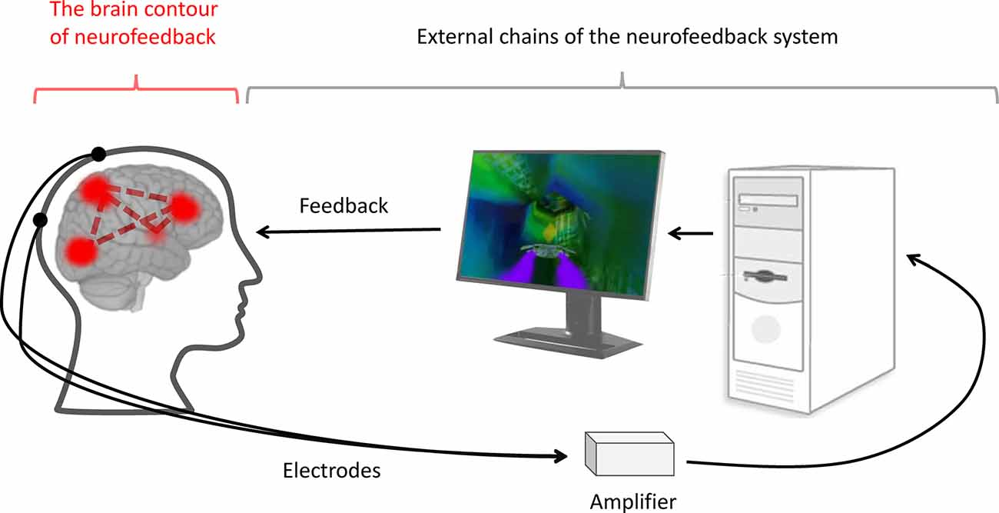
Biofeedback (BF), Neurofeedback (NF), Massage
Biofeedback and Neurofeedback
Imperatori 2018: BF and NF could help with food cravings, rumination; no changes in body image perception
Kohl 2019: FMRI and neurofeedback: Increase in dorsolateral prefrontal cortex activity. Positive effects on eating behaviors after a single day.
Massage
Field 1998, Hart 2001: Immediate effects - improved mood, lower anxiety and cortisol level. Long-term - improved eating disorder attitudes on the EDI (eating disorder inventory)
Zakers 2023: “Interventions that allow a strong therapeutic alliance to form, could be a beneficial healing adjunct therapy for patients with AN, especially in an inpatient setting, where the necessity of enforcing behavioral change makes the relationship between the medical practitioners and the sufferers of AN often challenging and complex.”
This Photo by Unknown Author is licensed under CC BY

Slide 68
Expressive Therapies
Music Therapy and Music Medicine
Testa 2020: Recommend listening to classical music, group singing, vodcasts, songwriting, sessions with a Body Monochord. Avoid music videos - reinforces preoccupation with physical appearance. Songwriting with music therapists is the most helpful due to its ability to elicit issues not revealed to the therapeutic team
Art Therapy
Griffin 2021: No RCT in support
Music, Art Therapy and CBT
Wang 2021: Improved depression and anxiety, helped establish correct cognition regarding food, body shape, weight. Promising results but unclear if can separate the effects of CBT and Arts
Dance therapy
Savidacki 2020: Improved mood states and body image. No difference in alexithymia
Movement
Vancamfort 2013: Aerobic and resistance training increased muscle strength, BMI, body fat % in AN. Aerobic exercise improved eating pathology. Recommend with caution. PT supervision could diminish exercise related risks in certain ED patients
This Photo by Unknown Author is licensed under CC BY-NC-ND

Slide 69
Acupuncture, Bright Light Therapy, Spirituality and Religion
Acupuncture
Fogarty 2010: Improves QoL, decreases anxiety (consider use pre-meals) and expression of perfectionism. No difference in empathy and therapeutic relationship with acupressure plus light massage
Bright light therapy
Beauchamp 2016: Significant improvement in eating pathology and comorbid depressive symptoms for the treatment period regardless of type of ED. Unclear if effects persist once treatment ceases
Spirituality and Religion
Akrawi 2015: Lower levels of disordered eating, psychopathology and body image concerns with strong religious beliefs. Prayers and body-affirming religious readings effective as coping strategies.
Richards 2007: Significantly lower psychological disturbance, ED symptoms and higher spiritual wellbeing in the spirituality group

Slide 70
Other Therapies
EMDR: Balboa 2017: Positive effects even 1 year after follow up, but not enough evidence to support the efficacy of EMDR
EFT vs CBT
Stapleton 2016
Outcome data collected at baseline, post-intervention (8 week), and 6- and 12-mo follow-up. Overall, EFT and CBT demonstrated comparable efficacy in reducing food cravings, one’s responsiveness to food in the environment (power of food), and dietary restraint, with Cohen’s effect size values suggesting moderate to high practical significance for both interventions.
BMI did not change. F/U study- Anxiety and depression scores significantly decreased from pre-to post intervention for the EFT group, only depression scores did the same for CBT. Both were maintained at 6- and 12-mo follow-up. Somatoform scores significantly decreased from pre-intervention to all follow-up points for the CBT group. EFT did not have this effect. Recommend as adjunct for BED.
Mindfulness:
Grohman 2021: Reduced binge eating severity at the end of trials. Benefits not maintained at follow-up
Notes:
Two decades of mindfulness-based interventions for binge eating: A systematic review and meta-analysis Dominique Grohmann, Keith R. Laws
Objective: Mindfulness-based interventions (MBIs) are being increasingly used as interventions for eating disorders including binge eating. This systematic review and meta-analysis aimed to assess two decades of research on the efficacy of MBIs in reducing binge eating severity. Methods: We searched PubMed, Scopus and Cochrane Library for trials assessing the use of MBIs to treat binge eating severity in both clinical and non-clinical samples. The systematic review and meta-analysis was preregistered at PROSPERO (CRD42020182395). Results: Twenty studies involving 21 samples (11 RCT and 10 uncontrolled samples) met inclusion criteria. Random effects meta-analyses on the 11 RCT samples (n = 618: MBIs n = 335, controls n = 283) showed that MBIs significantly reduced binge eating severity (g = − 0.39, 95% CI -0.68, − 0.11) at end of trial, but was not maintained at follow-up (g = − 0.06, 95% CI, − 0.31, 0.20, k = 5). No evidence of publication bias was detected. On the Cochrane Risk of Bias Tool 2, trials were rarely rated at high risk of bias and drop-out rates did not differ between MBIs and control groups. MBIs also significantly reduced depression, and improved both emotion regulation and mindfulness ability. Conclusion: MBIs reduce binge eating severity at the end of trials. Benefits were not maintained at follow-up; however, only five studies were assessed. Future well-powered trials should focus on assessing diversity better, including more men and people from ethnic minority backgrounds

Slide 71
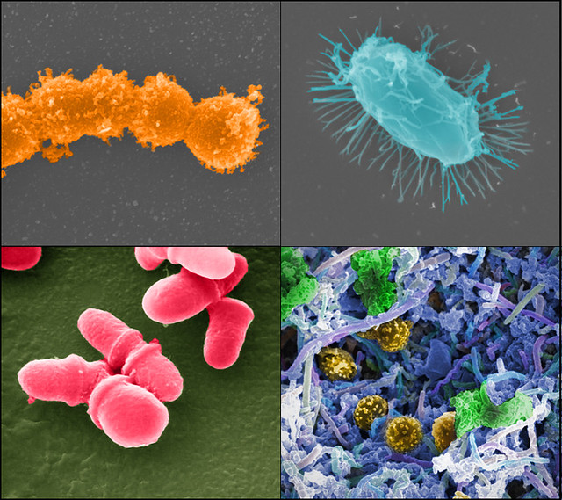
Nutrition and Microbiome
Carbone 2020
16 studies were included, mostly regarding AN.
AN: Alpha diversity (lower diversity) and lower short chain fatty acid (SCFA) levels
Lower alpha diversity and SCFAs causes dysbiosis this promotes intestinal inflammation, alters gut permeability, and triggers immune reactions in the hunger/satiety regulation center contributing to the pathophysiological development of EDs.
Microbial richness increased in AN after weight regain on fecal microbiota transplantation
AN inpatient stay: high calorie diet includes cow’s milk foods. Animal-based foods can result in abundance of particular microbial species resulting in an increase in certain inflammation-inducing bacteria and a “leaky gut”, which could aggravate chronic low-grade inflammation
?AN is an autoimmune disease caused by changes in the microbiome where autoantibodies to appetite-regulating neuropeptides, neurotransmitters, and hypothalamic neurons, disturb appetite, result in decreased intake of food
This Photo by Unknown Author is licensed under CC BY-NC
Notes:
Zakers
Interest in the link between AN (AN) and autoimmune disorders has arisen. Of note, region rs4622308 on chromosome 12 has also been linked to autoimmune diseases.3 This link between EDs and inflammatory processes was further studied, showing a solid bidirectional relationship between ED and autoimmune disease.4,5 In addition, these studies also discovered an association between ED and the microbiome.. Micronutrients, vitamins, and probiotics are frequently used as adjunctive treatment in patients with ED to support physical body functioning but do not treat core symptoms. The microbiome in AN may be important during treatment in the hospital. AN patients often eat vegetarian or vegan diets low in fat and carbohydrates and high in protein and fiber before therapy. Hospital food is mostly high in calories and rich in carbohydrates and fat and patients requiring oral supplements or nasogastric feeding mostly receive products based on cow’s milk. Animal-based foods have been shown to rapidly change the abundance of particular microbial species when previously maintained on a vegetarian diet resulting in an increase in certain inflammation-inducing bacteria95 and a “leaky gut”. This inflammatory process may aggravate a chronic low-grade inflammation presumed to be present in AN patients. It has been hypothesized that AN is an autoimmune disease caused by changes in the microbiome in which autoantibodies to appetite-regulating neuropeptides, neurotransmitters, and hypothalamic neurons, disturb appetite and result in decreased intake of food. Therefore, more research must be done to determine what foods eaten during refeeding will not perpetuate the AN, what microbiota would be beneficial to prevent the production of these autoantibodies, and how changes in the microbiome (dysbiosis) play a role in depression and anxiety associated with AN.96,97 In fact, a systemic review of the role of microbiota and ED and treatment revealed microbiota homeostasis seems essential for a healthy communication network between the gut and brain. Dysbiosis may promote intestinal inflammation, alter gut permeability, and trigger immune reactions in the hunger/satiety regulation center contributing to the pathophysiological development of EDs. Lower diversity (alpha diversity) in the microbiome seen in AN leads to dysbiosis. There is an increase in auto-antibodies to a-melanocyte stimulating hormone (a-MSH) which affects satiety centers to reduce appetit

Slide 72
BEfree: A New Psychological Program for Binge Eating that Integrates Psychoeducation, Mindfulness, and Compassion
6‐month postintervention program based on psychoeducation, mindfulness, and self‐compassion for obese/overweight women +BED.
N:BEfree (n = 19), wait list group (WL; n = 17)
Results
Effective in eliminating BED; in diminishing eating psychopathology, depression, shame and self‐criticism, body‐image psychological inflexibility, and body‐image cognitive fusion; and in improving obesity‐related quality of life and self‐compassion
Results maintained at 3‐ and 6‐month follow‐up.
helpful for dealing with impulses and negative internal experiences.
Conclusions: These results seem to suggest the efficacy of BEfree and the benefit of integrating different components such as psychoeducation, mindfulness, and self‐compassion when treating BED in obese or overweight women.
Pinto-Gouveia 2017
Notes:
José Pinto‐Gouveia1 | Sérgio A. Carvalho1 | Lara Palmeira1 | Paula Castilho1 | Cristiana Duarte1 | Cláudia Ferreira1 | Joana Duarte1 | Marina Cunha1,2 | Marcela Matos1 | Joana Costa1
Clin Psychol Psychother. 2017;24:1090–1098
Background Binge eating disorder (BED) is associated with several psychological and medical problems, such as obesity. Approximately 30% of individuals seeking weight loss treatments present binge eating symptomatology. Moreover, current treatments for BED lack efficacy at follow‐up assessments. Developing mindfulness and self‐compassion seem to be beneficial in treating BED, although there is still room for improvement, which may include integrating these different but complimentary approaches. BEfree is the first program integrating psychoeducation‐, mindfulness‐, and compassion‐based components for treating women with binge eating and obesity. Objective To test the acceptability and efficacy up to 6‐month postintervention of a psychological program based on psychoeducation, mindfulness, and self‐compassion for obese or overweight women with BED. Design A controlled longitudinal design was followed in order to compare results between BEfree (n = 19) and waiting list group (WL; n = 17) from preintervention to postintervention. Results from BEfree were compared from preintervention to 3‐ and 6‐month follow‐up. Results BEfree was effective in eliminating BED; in diminishing eating psychopathology, depression, shame and self‐criticism, body‐image psychological inflexibility, and body‐image cognitive fusion; and in improving obesity‐related quality of life and self‐compassion when compared to a WL control group. Results were maintained at 3‐ and 6‐month follow‐up. Finally, participants rated BEfree helpful for dealing with impulses and negative internal experiences. Conclusions These results seem to suggest the efficacy of BEfree and the benefit of integrating different components such as psychoeducation, mindfulness, and self‐compassion when treating BED in obese or overweight women. Key Practitioner Message • The current study provides evidence of the acceptability of a psychoeducation, mindfulness, and compassion program for binge eating in obesity (BEfree); • Developing mindfulness and self‐compassionate skills is an effective way of diminishing binge eating, eating psychopathology and depression, and increasing quality of life in women with obesity; • Integrating psychoeducation, mindfulness, and compassion seem to be effective in diminishing binge eating, with results maintained up to 6‐month postintervention.

Slide 73
Introducing a Smart Toy in Eating Disorder Treatment: A Pilot Study
Novel technology-enabled smart toy, Purrble, designed for immediate assistance in emotion regulation
Mixed-method approach involving workshops, diaries, and focus groups was employed to examine the feasibility of Purrble as a therapeutic tool and its impact on participants’ daily routines, sensory experiences, and emotional states
Results demonstrate the engagement and acceptability of the device
Qualitative analysis: independently used and integrated Purrble into their emotional and sensory regulation practices
Notes:
Individuals with eating disorders (EDs) often encounter challenges related to body image, emotional, and sensory difficulties during nutritional rehabilitation. To address these challenges, a novel technology-enabled smart toy, Purrble, designed for immediate assistance in emotion regulation, is being explored. A mixed-method approach involving workshops, diaries, and focus groups was employed to examine the feasibility of Purrble as a therapeutic tool and its impact on participants’ daily routines, sensory experiences, and emotional states. The study results demonstrate the engagement and acceptability of this device. Qualitative analysis revealed that participants independently used and integrated Purrble into their emotional and sensory regulation practices. These pilot results support the potential for a shift in the delivery of adjunct therapeutic tools through technology, particularly for ED patients with complex presentations. Future research is necessary to further explore the psychological benefits of this intervention.
: Chubinidze, D.; Li, Z.; Slovak, P.; Baudinet, J.; Dufour, E.; Tchanturia, K. Introducing a Smart Toy in Eating Disorder Treatment: A Pilot Study. Nutrients 2024, 16, 467. https://doi.org/10.3390/nu16040467

Slide 74
CHOP Experience
“Majority of the adolescent inpatient admissions are for ED, severe malnutrition and monitoring for refeeding syndrome. Many have ARFID and some have AN and are on a vigorous refeeding protocol. Majority have anxiety and stress. Approach is compassion for their situation and acknowledge the stress they are experiencing as well as nausea and abdominal pain from suddenly refeeding their bodies. We address the physical and emotional symptoms with aromatherapy, (lavender, mandarin, and/or peppermint ginger), acupressure- acu bands and/seeds, breathwork/yoga practices that are less about physical postures (asana); with more focus on mindfulness, relaxation, self compassion and acceptance. These techniques at their core help alleviate anxiety and help the GI system restart. Many of the patients appreciate our interventions and get relief. These are tools they can take with them after they leave the hospital environment.”
“IH and Adolescent medicine have formed a great relationship! We've fostered an integrative and collaborative approach between all disciplines from physicians, APP's, nursing, child life services, chaplain services and art and music therapy. The patients even share with each other the benefits of the modalities they've received! This includes the use of aromatherapy, massage therapy, as well as the group I lead every week where they learn relaxation through mind-body based techniques. It is truly a fully collaborative and supportive environment and culture.

Slide 75
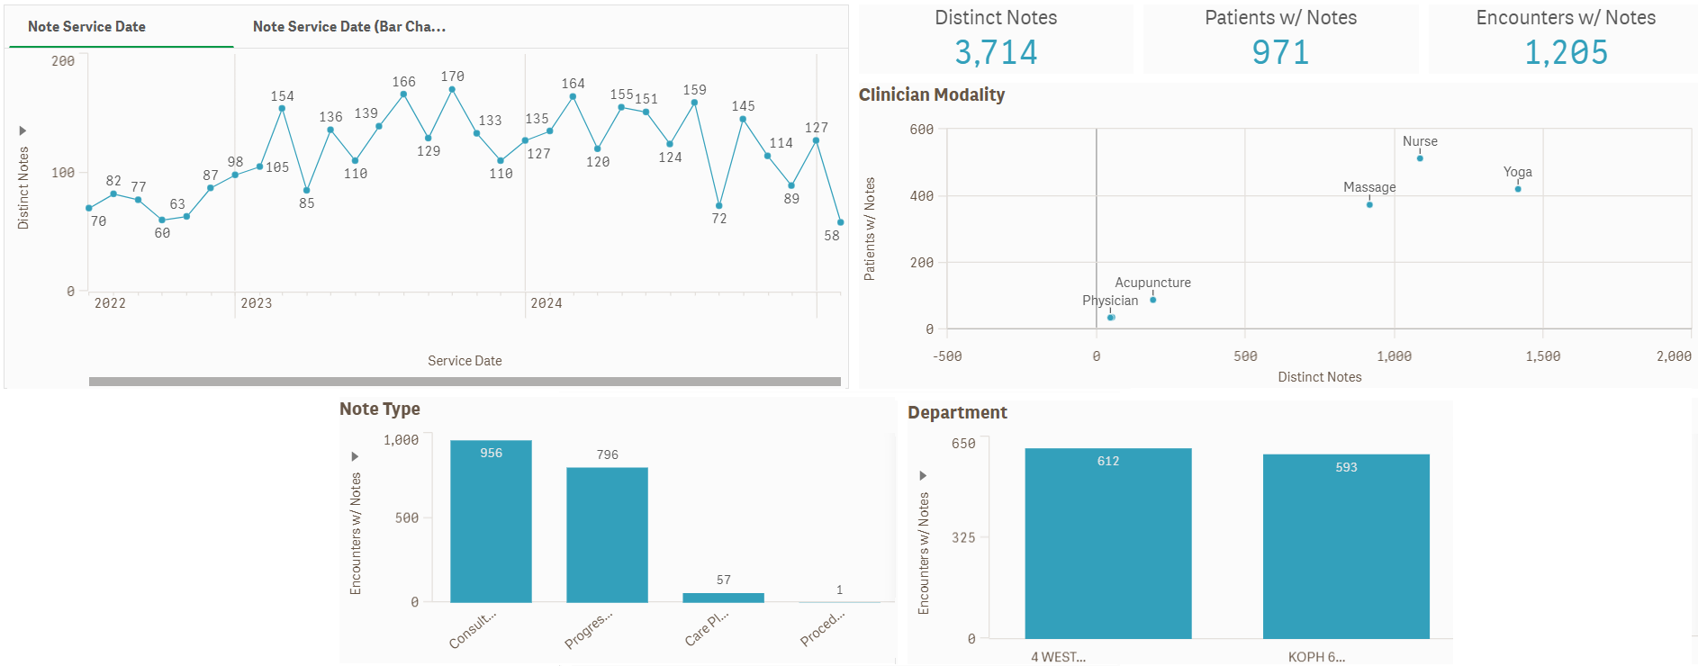
Integrative Health in Adolescent Medicine at CHOP: FY22-Present

Slide 76
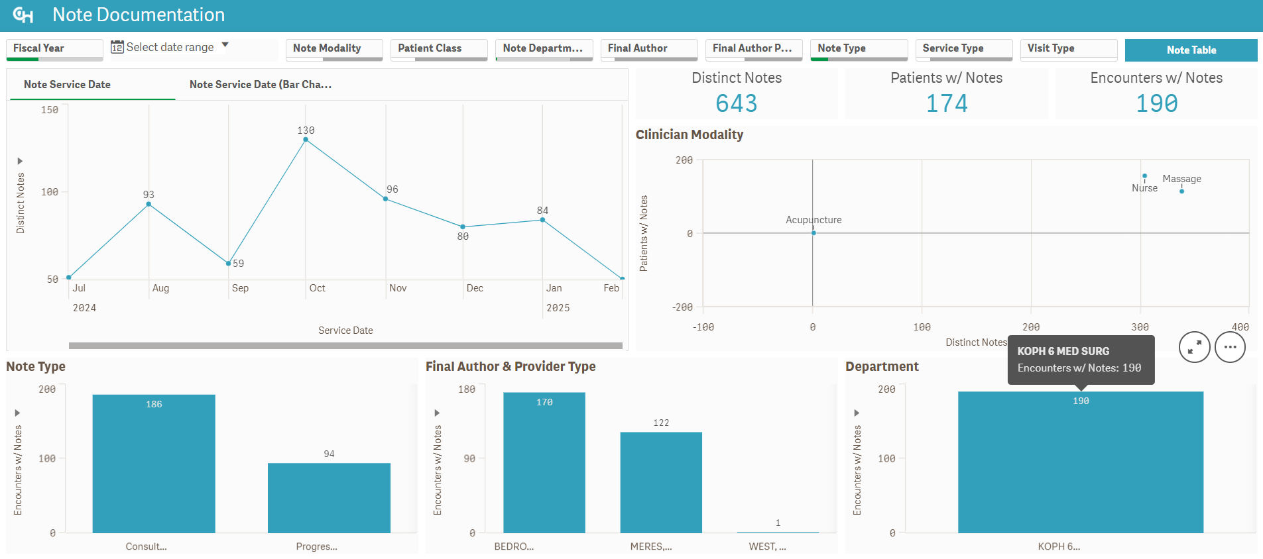
Integrative Health in Adolescent Medicine at King of Prussia: FY25

Slide 77
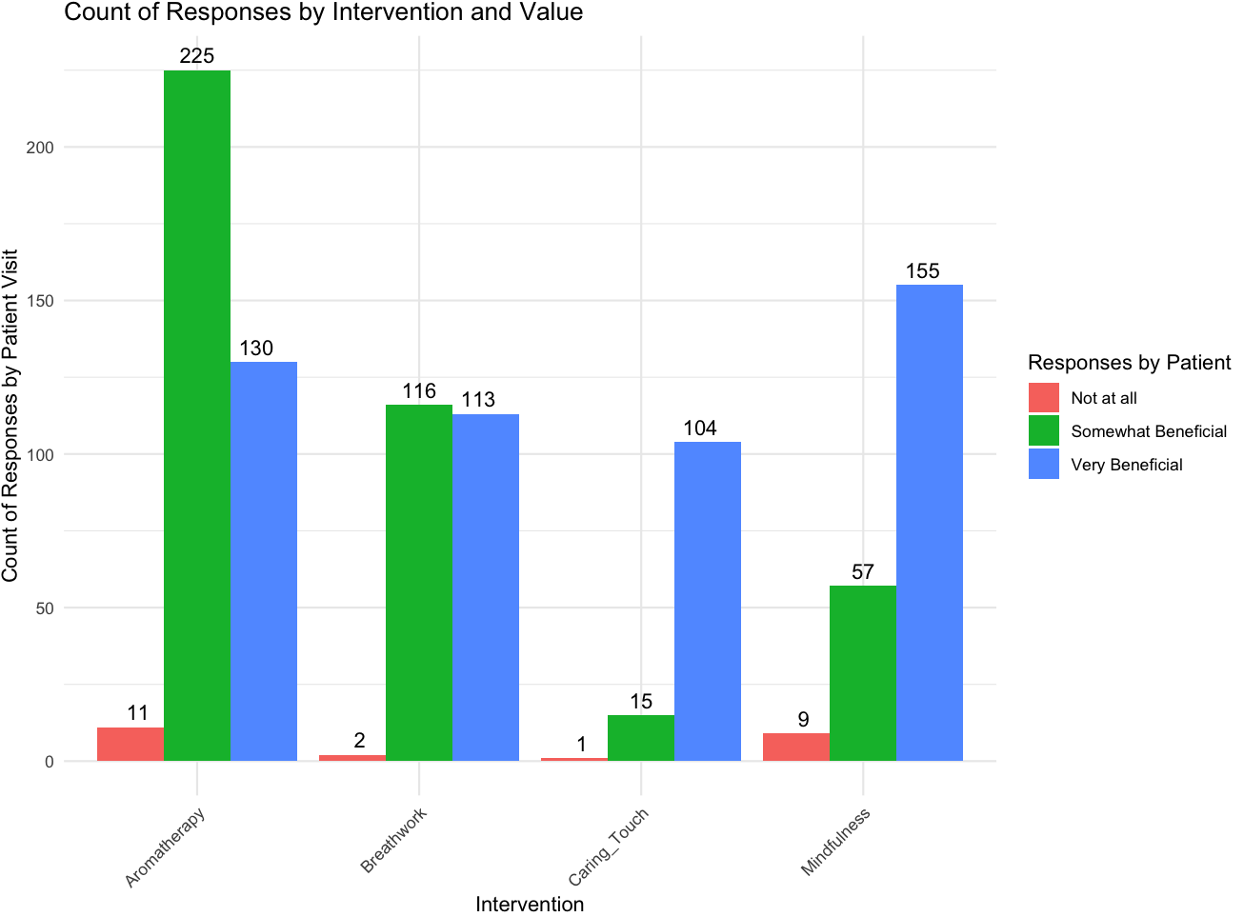
Patient Responses to Various Interventions (KOPH 6 Med Surge)
N=938

Slide 78
Real world story
“A 17-year-old patient explained to me that they had learned breathwork and mindfulness at school as well as at therapy. We had built a good rapport; yet he would kindly decline to go to my group or try any of my offerings. He was open to massage therapy consults and shared that he found them very relaxing. He was admitted multiple times, and early into his second admission he opened up that he did not believe things such as breathwork or mind-body practices could be helpful for his anxiety and stress. I was able learn from his past experiences and reframe the potential applications of the practices. Through building a trusting relationship he felt safe to give them a try, and after this he joined most of my groups as well as working one-on-one many times. He always would smile and remind me that he had never believed in these practices until we started working together.”
This Photo by Unknown Author is licensed under CC BY-SA-NC
Notes:
The majority of the adolescent inpatient admissions are for eating disorders that have resulted in severe malnutrition and require monitoring for refeeding syndrome. (Orthostatic VS and electrolyte derangements that require close monitoring. Many of the patients have ARFID and some have various types of anorexia. They are on a vigorous refeeding protocol.
As you might imagine, the majority of these patients have anxiety and stress. I approach these patients with compassion for their situation and acknowledge the stress they are experiencing as well as nausea and abdominal pain from suddenly refeeding their bodies. We address the physical and emotional symptoms with aromatherapy, (lavender, mandarin, and/or peppermint ginger) acupressure- acu bands and/seeds, breathwork/yoga practices that are less about physical postures (asana) and more focus on mindfulness, relaxation and self compassion and acceptance. These techniques at their core help alleviate anxiety and help the GI system restart. Many of the patients appreciate our interventions and get relief. These are tools they can take with them after they leave the hospital environment.
Lisa Squires
IH and Adolescent medicine have formed a great relationship! We've fostered an integrative and collaborative approach between all disciplines from physicians, APP's, nursing, child life services, chaplain services and art and music therapy. The patients even share with each other the benefits of the modalities they've received! This includes the use of aromatherapy, massage therapy, as well as the group I lead every week where they learn relaxation through mind-body based techniques. It is truly a fully collaborative and supportive environment and culture.
micah

Slide 79
Another real world story….
“A mother and her 12 yo daughter felt a lot of stress related to hospitalization and her course of treatment. The patient was very anxious related to meals and would sometimes need an ng tube placed. I was able to work with her using aromatherapy and gentle, guided breathing techniques to help her through the stressors. The nursing team and I would coordinate care, especially during uncomfortable interventions. Other times she would fall asleep for the first time that day during guided relaxations. I would also consult with the art and music therapists. It was of great benefit to both child and family.”
Notes:
The majority of the adolescent inpatient admissions are for eating disorders that have resulted in severe malnutrition and require monitoring for refeeding syndrome. (Orthostatic VS and electrolyte derangements that require close monitoring. Many of the patients have ARFID and some have various types of anorexia. They are on a vigorous refeeding protocol.
As you might imagine, the majority of these patients have anxiety and stress. I approach these patients with compassion for their situation and acknowledge the stress they are experiencing as well as nausea and abdominal pain from suddenly refeeding their bodies. We address the physical and emotional symptoms with aromatherapy, (lavender, mandarin, and/or peppermint ginger) acupressure- acu bands and/seeds, breathwork/yoga practices that are less about physical postures (asana) and more focus on mindfulness, relaxation and self compassion and acceptance. These techniques at their core help alleviate anxiety and help the GI system restart. Many of the patients appreciate our interventions and get relief. These are tools they can take with them after they leave the hospital environment.
Lisa Squires
IH and Adolescent medicine have formed a great relationship! We've fostered an integrative and collaborative approach between all disciplines from physicians, APP's, nursing, child life services, chaplain services and art and music therapy. The patients even share with each other the benefits of the modalities they've received! This includes the use of aromatherapy, massage therapy, as well as the group I lead every week where they learn relaxation through mind-body based techniques. It is truly a fully collaborative and supportive environment and culture.
micah

Slide 80
Thank You!
References and Resources
Melanie A. Gold – mag2295@cumc.Columbia.edu
Maria R. Mascarenhas – MASCARENHAS@chop.edu
David W. Miller – David.Miller6@UHHospitals.org
Notes:
What is EMDR? - EMDR Institute - EYE MOVEMENT DESENSITIZATION AND REPROCESSING THERAPY
About EMDR Therapy - EMDR International Association
Eye Movement Desensitization and Reprocessing (EMDR) Therapy
There are many different breathing exercises
Bright Light Therapy | Stanford Health Care
https://sl.bing.net/gjudX8v67Eq

